Slide 1

Assessment in Postgraduate FM Residency
DFCM
Faculty Development
THE ROAD TO COMPETENCY

Slide 2
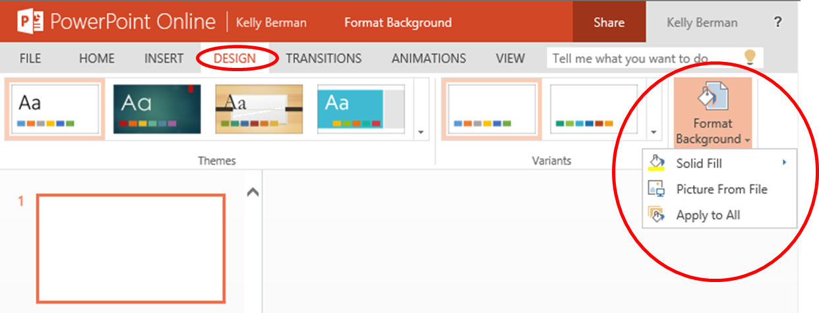
How to use these slides
Slides with
coloured background are the barebones and are TO BE REVIEWD by all
coloured background are guides for presenters and are hidden
coloured background are optional
To remove the coloured background CLICK on DESIGN tab & far right CLICK FORMAT BACKGROUND under Colour CLICK on the PAINTCAN picture and choose Automatic or White
The Notes section has added information for presenters
White
Pink
Blue

Slide 3

WHY
WHAT
HOW
WHY COMPETENCY BASED MEDICAL EDUCATION (CBME)
WHAT TOOLS ARE AVAILABLE FOR RESIDENT ASSESSMENT & EVALUATION
HOW TO COMPLETE A FIELD NOTE AND GIVE FEEDBACK
THE ROAD TO COMPETENCY ASSESSMENT
Notes:
This slide outline the 3 main sections of the presentation. Each section will start with this slide with the section title in regular colour and the rest faded out.

Slide 4
WHY
WHAT
HOW
WHY COMPETENCY BASED MEDICAL EDUCATION (CBME)
WHAT TOOLS ARE AVAILABLE FOR RESIDENT ASSESSMENT & EVALUATION
HOW TO COMPLETE A FIELD NOTE AND GIVE FEEDBACK
THE ROAD TO COMPETENCY ASSESSMENT
Notes:
The WHY section-This is very short as its all covered in the Competency module

Slide 5

Assessment and the
CFPC Standards of Accreditation
Element 3.4: There is an effective, organized system of resident assessment
3.4.1: The residency program has a planned, defined and implemented system of assessment.
3.4.2: There is a mechanism in place to engage residents in regular discussions for review of their performance and progression
Notes:
The CFPC Standards of Accreditation requires an effective, organized system of assessment for residents, and a mechanism to ensure residents have regular opportunities to review their performance and progression. It is our hope that this module of assessment has provided attendees with an opportunity to review the DFCM system of resident assessment in detail, to become familiar with how to complete field notes and ITERs and to understand how one form of resident assessment informs other formats(i.e. field notes or “micro level of assessment” informing ITERS/progress reviews “meso level of assessment”, informing decisions on progress “macro level of assessment”).

Slide 6
COMPETENCY
ENTRUSTMENT SCALES
OUTCOMES BASED APPROACH
Level
of trust
Based on level of supervision
  Based on observation
  Demonstrate skill is achieved
A shift from determination of level of training to determining level of competence
Notes:
This slide is a quick review of how we have moved to assessing competency and levels of trust.

Slide 7



WHY SWITCH TO CBME?
BETTER VALIDITY AND RELIABILITY
When decisions rooted in “trust” about safe/independent practice
MORE HONEST RATINGS
Aides “failure to fail”
LEARNERS ACCEPT LOWER
RATINGS BETTER
If paired with concrete verbal/written feedback
Notes:
From Royal college http://www.royalcollege.ca/mssites/entrustability/index.html#/lessons/W2SWSYAnG_O3UQZPk-qcrJPH_32qklo3?_k=j2wk6u (accessed Oct 2019)
This is a good time to discuss Failure to Fail- in the old field notes it was very hard to say you were “below expectations” . Are faculty afraid to give a low rating. What are the repercussions to Resident and Preceptor. In the old system below expectations was a warning flag to program directors.
When traditional anchors are replaced with anchors based on entrustment, raters are more discriminating of trainee performances and the reliability of ratings significantly improves.
Eexperience with entrustment anchors suggests that clinical raters are more likely to provide honest ratings.
Trainees are more willing to accept lower scores if these are accompanied by concrete verbal and written feedback required to improve their future performance.

Slide 8
WHY
WHAT
HOW
WHY COMPETENCY BASED MEDICAL EDUCATION (CBME)
WHAT TOOLS ARE AVAILABLE FOR RESIDENT ASSESSMENT & EVALUATION
HOW TO COMPLETE A FILED NOTE AND GIVE FEEDBACK
THE ROAD TO COMPETENCY ASSESSMENT

Slide 9

What guides assessment in CBME
Direct observation while trainees provide care is the cornerstone of the assessment and evaluation process
THE FIELD NOTE (FN)
Notes:
While direct observation is ideal a field note can be completed on a partly observed or reported encounter as well as many non patient encounters such as following up on results, going the extra mile after hours, not responding to emails etc.

Slide 10
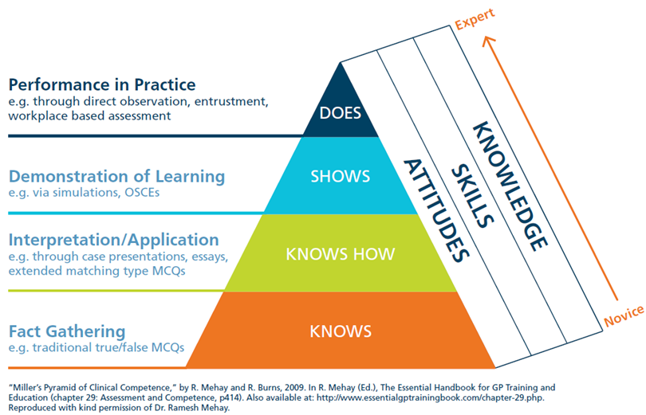
Miller's Competence Triangle
Notes:
This slide demonstrates that most of our commonly used assessment methods (i.e MCQ’s, ITERS, Projects) do not get at what a trainee does on a typical clinical day. We need our faculty to understand the importance of assessing trainees in the real clinical environment so that we can ensure that they perform competently there.

Slide 11

A New Field note System
"...the most important modification to improve in-training assessment is the gathering and documentation of case specific comments and feedback with reflection and coaching from the preceptor to the resident during daily clinical work"
-CFPC Working Group on Certification Process
A COACHING NARRATIVE
Notes:
Programs need to meet a list of standards broken down by requirements and indicators
Best way to demonstrate Feedback and Assessment is through a standardized and evidence-based documentation process

Slide 12
Field Notes in Family Medicine
REAL TIME
USER FRIENDLY
MARKER
Brief documents that record observations made and feedback provided.
Online system is easy to use and available on different devices
Serve as a marker that clinical competence has been assessed
Multiple FN leads to more reliable assessment
Notes:
Can be fully observed, partly observed, reported or not a patient encounter.
You can only do 1 CanMeds role/EPA at a time per Field Note but you can assess different EPA’s based on the same encounter i.e. one assessing Communicator role another the Professional one. While its possible do 10 Field notes on one single encounter- it will add over-sampling bias

Slide 13
RESIDENTS
Review for self-reflection
Identify areas of weakness
Look for development over time
PRECEPTOR
Track-How many done
-What CanMeds/EPA covered
Ideally equally distributed
Build documentation for learner in difficulty
Identify areas to work on
Complete POWER evaluations/ITERs*
HOW ARE FN USED?
PROGRAM DIRECTOR
Complete ITERS
6 month progress reviews
Notes:
ITER- In training Evaluation Report - completed through POWER portal
*Some preceptors might not be responsible to complete ITERS as it’s a composite evaluation from all teachers supervising the rotation.

Slide 14

HOW MANY FIELD NOTES?
  Enough to complete their ITER (In-Training Evaluation Report)
  Strive for 1 FN/clinical half day
Notes:
Traditionally Frequency/quantity of FN has been a weakness
Not setting numbers
Aim
>3/week on Block
>1/wk. on Longitudinal
35 FN/yr.
70 in total

Slide 15

FIELD NOTES: Day to Day
  How to incorporate Field Notes into a busy clinical teaching day?
  Time Management
  Any tips?
Notes:
Slide here is to use to start a discussion on the practical implementation of Filed Notes
Does anyone have any tips? A few ideas below
Teaching huddles at the start of the day to decide who and what to focus on
Doing it on your phone
Have the resident initiate it

Slide 16



New Field Notes
What is different?
Resident or preceptor driven
Can be completed on mobile device
Entrustment scales

Slide 17
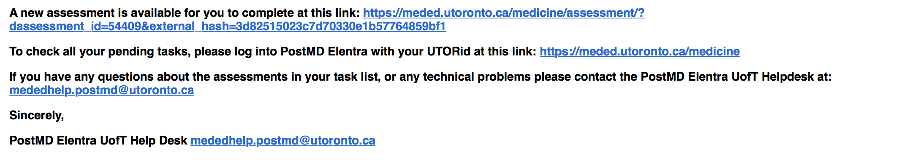
New Field Notes
Resident Initiated
What is different?
3 types
Self assessment
  Resident completes on their own
  Preceptor receives notice of completion
Resident initiates assessment
  Resident completes part of the FN
  Email sent to Preceptor for input and sign off
Resident sends prompt (picture below)
  Email sent to supervisor to complete
  Resident can send triggering info/outside notes
Residents can Initiate!
Notes:
There are 3 ways (each with a different purpose) a Resident can initiate a FN
Self assessment:
Resident completes the whole note on their own
Preceptor receives notice that a FN was completed but cannot see content
2. Resident initiates the assessment
-email is sent to Preceptor for modification, approval and sign off
-resident can choose the CanMeds category
3. Resident send prompt
-email sent to supervisor to complete an assessment
-Resident can pick CanMeds role
-Resident can send triggering info or notes that are NOT part of the FN i.e. pt illness to help remind Preceptor about the case
The bottom is an actual message from Elantra providing a direct link to fill out a FN.

Slide 18
The next slide is optional and shows you how to add field notes as a direct link/app on your iphone or android
You will need speakers and an internet connection
If you click on the pictures in slide show mode the videos will run (they do not run in normal view but copy the links in the notes or on the slide and put into your browser to test it out)

Slide 19
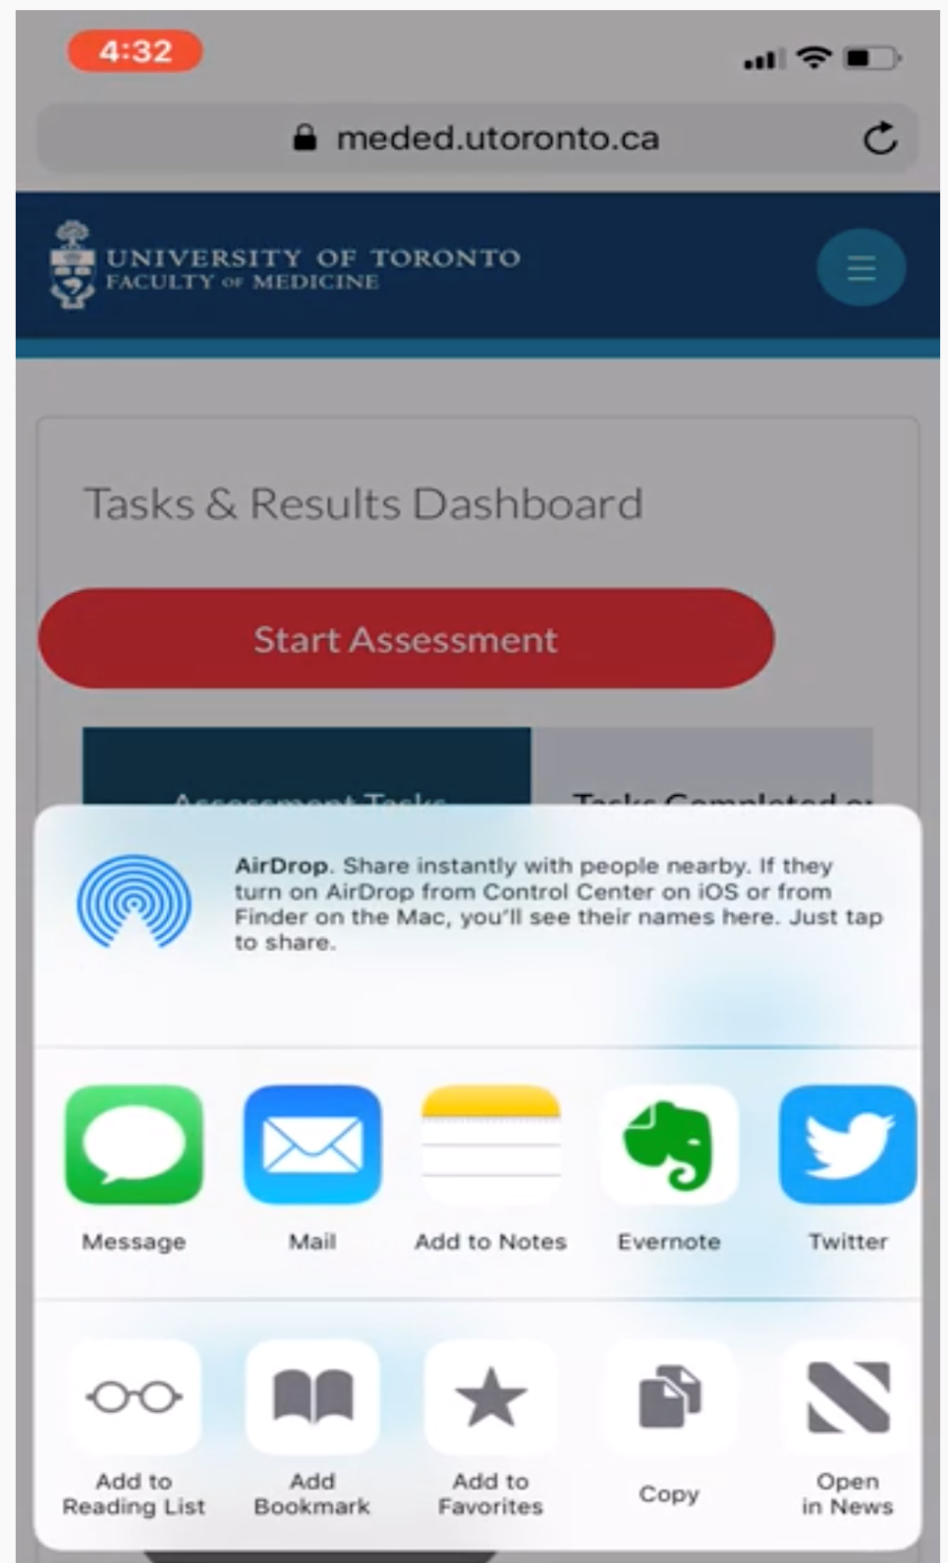
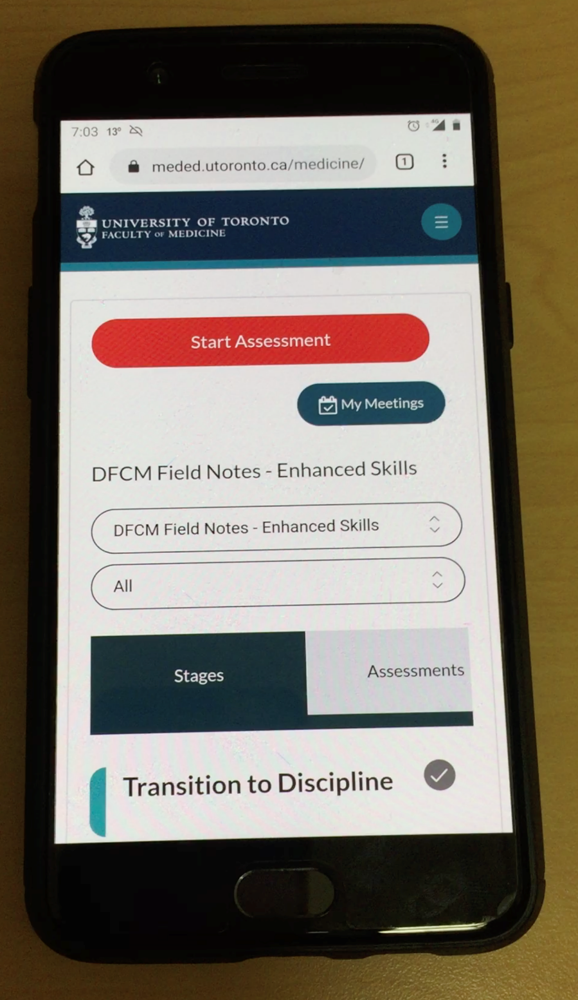
New Field Notes
How to link FNs to your phone
What is different?
Can be completed on mobile device
Iphone
https://www.youtube.com/watch?v=lqjn4no_X_M&feature=youtu.be
Android
https://youtu.be/KtbUYEEDgm4
Notes:
Clicking on the first picture (or link) opens up a 2:23 minute Youtube video of how to add field notes to you iphone
https://www.youtube.com/watch?v=lqjn4no_X_M&feature=youtu.be
Clicking on the second picture (or link) opens up a 1;12 minute YouTube video on how to add g filed notes to an android device
https://youtu.be/KtbUYEEDgm4
Note these links are also provided in the handout so faculty can do on their own time. You can send the links out ahead of time and ask people to do this in advance.

Slide 20
WHY
WHAT
HOW
WHY COMPETENCY BASED MEDICAL EDUCATION (CBME)
WHAT TOOLS ARE AVAILABLE FOR RESIDENT ASSESSMENT & EVALUATION
HOW TO COMPLETE A FIELD NOTE AND GIVE FEEDBACK
THE ROAD TO COMPETENCY ASSESSMENT
Notes:
Note: the following section is very interactive and has a joint fill in the blank, several videos and tools to use. You can pick what you want to cover depending on your faculty and the time allotted. The presentation can be broken into pieces and delivered at separate times or parts can be sent out by email as a self-learning exercise.

Slide 21
Optional Slides:
Filling out a FN
The following slides show
- How to log onto Elentra
-web addresses provided a series of visual step by step
-How to fill in a FN
-Parts of a FN
They are animated- to Preview the animations in Notes mode
-Click on Animations on the top red bar and click preview on the far left

Slide 22

How to Log onto Elentra
  Go to the Elentra website: https://meded.utoronto.ca/
  To log in to Elentra, enter your UTORid & password and click “log in”. You will be directed to your home page.
  User manual: http://cbme.postmd.utoronto.ca/u-of-t-cbme-faculty-resident-resources/references-resources/elentra-user-guides/
Notes:
Pleas show this slide and check in to make sure everyone knows how to start a FN

Slide 23
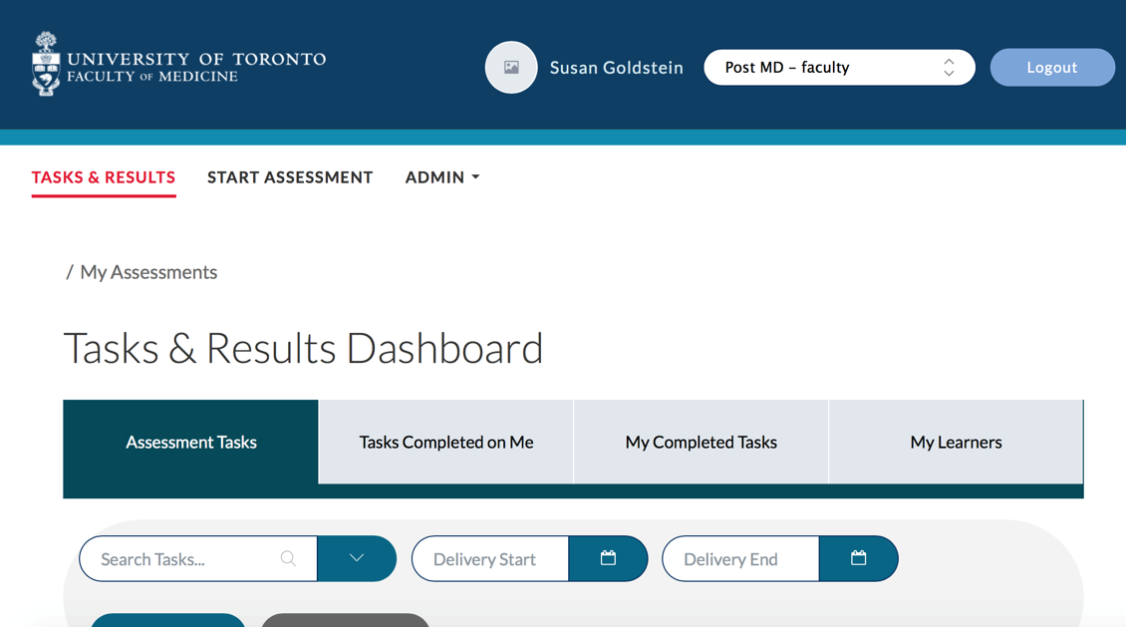

May need to change to post-MD faculty
How to start a new Field note
Notes:
Once you have signed in make sure the top second right bubble says Post MD-faculty
Click on Start Assessment

Slide 24
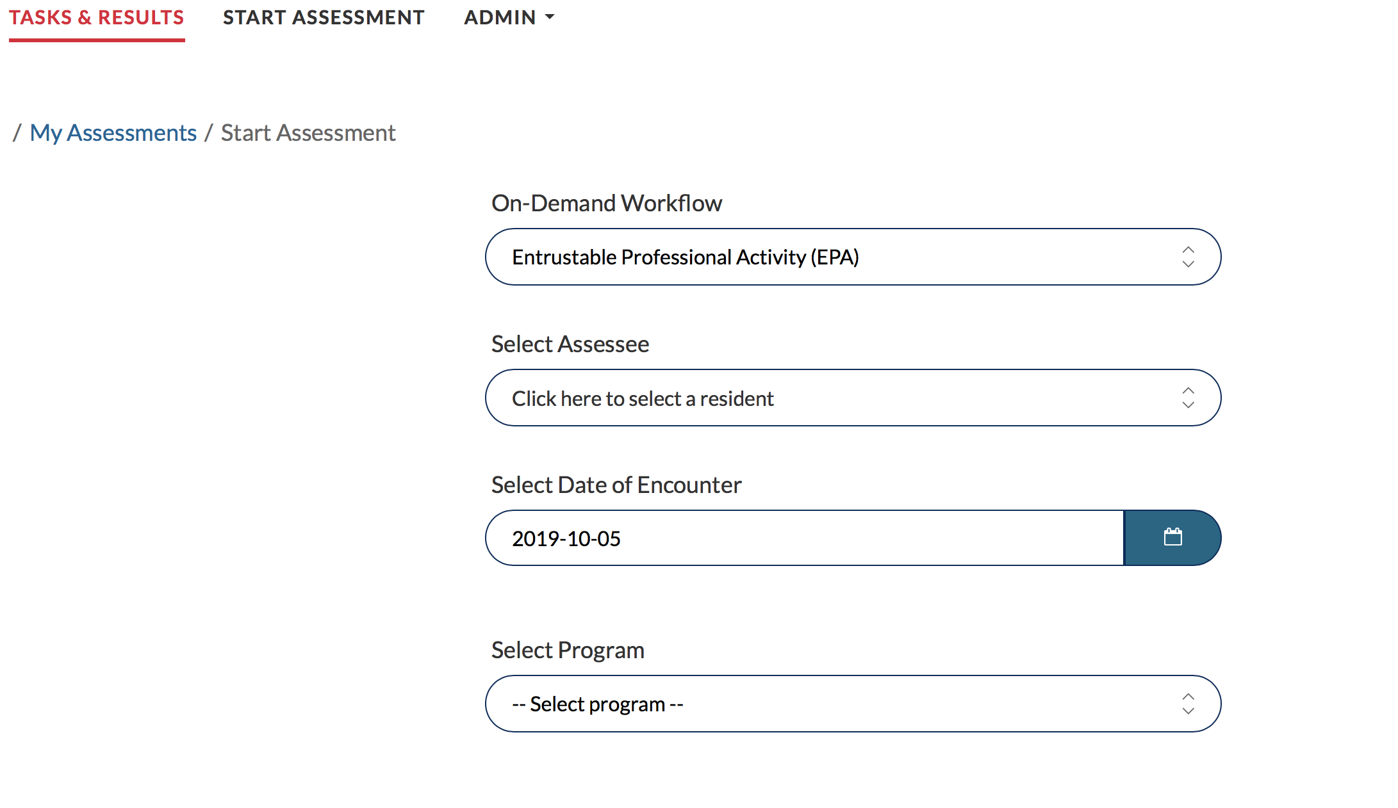
  Type the Learner’s name into the search box to narrow down the list. Once you find the Learner’s name, select for it by clicking on the circle
How to start a new Field note
Notes:
1st box: On-Demand Workflow-leave will self populate as an EPA
2nd box: Select assessee Start typing the name either first or last-chose the one that is more rare
3rd/4th box next slide

Slide 25
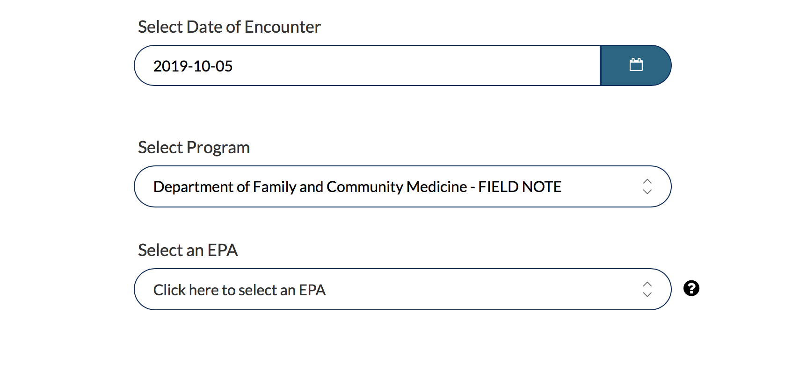
Default date can be changed
Program default is FM-FN
How to start a new Field note
Select and EPA/CanMEDS role
Notes:
Box 1: you can click on the blue calendar icon and change the date
Box 2: leave as is
Box 3: For more info see next slide

Slide 26

FM Expert
  Clinical Reasoning skills
  Patient Centered
  Procedures
  Selectivity
Health Advocate
Professional
Collaborator
Scholar
Communicator
Manager
How to start a new field note – Choose an EPA
Image from the CFPC’s CanMEDS – Family Medicine: Working Group on Curriculum Review
Notes:
Clicking on Preview this Form will show the skills for the EPA
As an example for FM Expert: Selectivity the following will show up:
FAM 2. Demonstrate the ability to effectively and selectively identify, assess and prioritize presenting symptoms.
FAM 5. Convey (to the observer) through the nature and sequence of the examination that the hypotheses from the history are being tested.
FAM 13. Select laboratory and imaging tests that are evidence-based, cost-effective and employ them only when they would have an impact on patient management.
FM Expert: Clinical Reasoning Skills
FAM 6. Demonstrate the core knowledge of Family Medicine, informed by evidence that is appropriate for level of training.
FAM 2. Elicit pertinent associated symptoms, red flags and risk factors.
FAM 2. Convey (to the observer) through the nature and sequence of questions, that diagnostic hypotheses are being generated and tested.
FAM 6. Construct an appropriately thorough differential diagnosis congruent with data gathered from the history and physical.
FAM 12. Modify the differential diagnosis in light of unexpected or changing symptoms or when symptoms persist beyond what one would ordinarily expect.
FAM 16. Develop and implement an appropriate treatment plan (including writing a complete prescription).

Slide 27
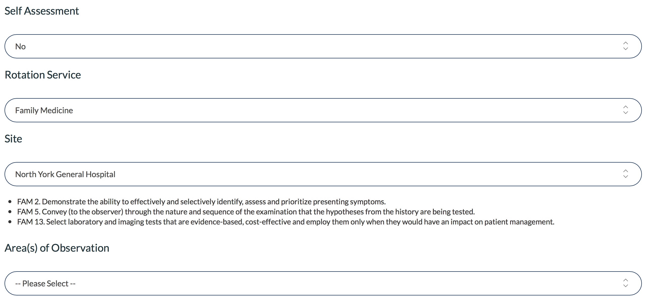
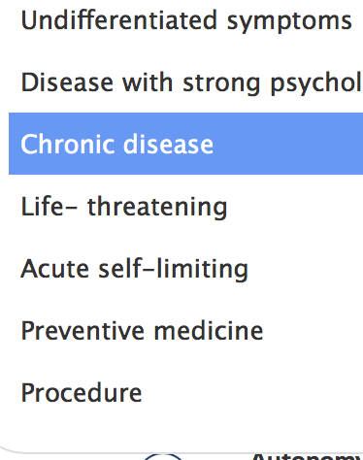
YES if resident initiated
Default is FM – can change to emerg/palliative etc.
How to start a new Field note
A drop down appears for area of observation
Notes:
Box 1: here is where a Resident enters Yes to open 3 different ways to do a FN (see slide 25 for more info)
Box 2: can be changed to Emergency medicine (bottom of the drop down?) , palliative
Below Site will be an Explanation of the Can Meds role you chose above under EPA i.e. the blue box
Areas of observation will fly in
-note: Not a pt encounter is missing from the bottom

Slide 28
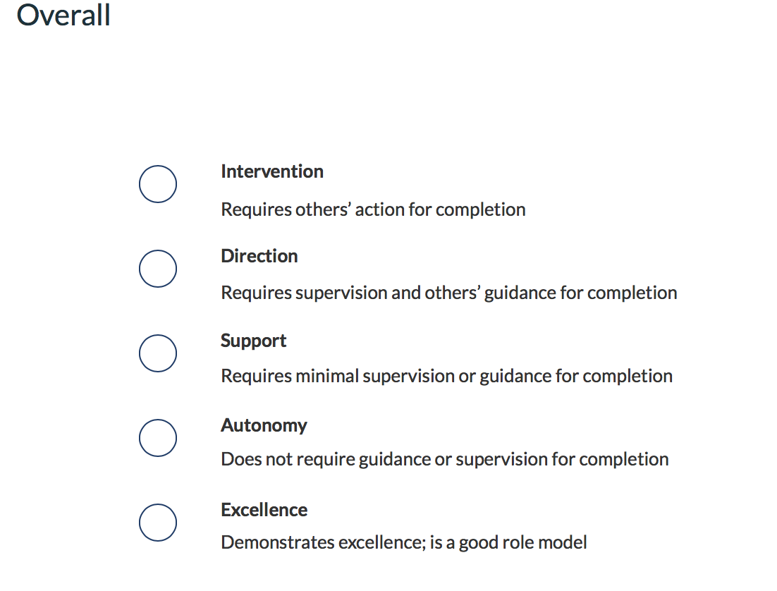

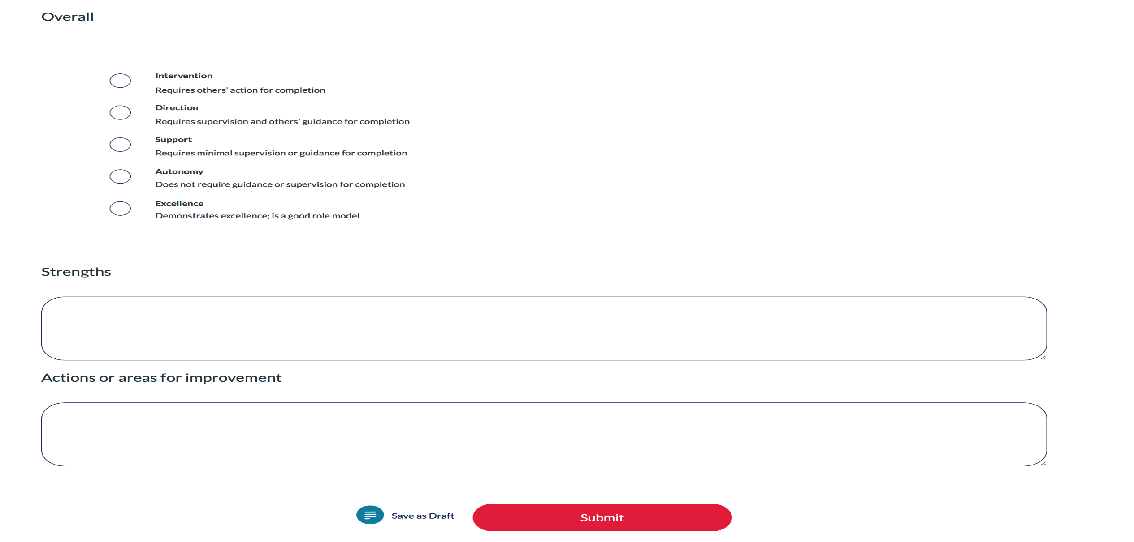
How to start a new Field note
-Choosing a level of entrustment
Narrative Boxes
Comment on
  Observed talent
Most important section
  Suggestions for improvement/action plan
  Be specific
  Behaviour-based comments
Notes:
Here's where the Entrustability scale comes in
Five levels
Encourage filling out narrative comments

Slide 29
How to give good feedback
Notes:
This is a title slide for the next section

Slide 30
The Next Slide can be an interactive game: it comes from TRUE Field Notes
Play the Game
Remove the Game
Audience reads the first 4 columns and tries to guess the level of trust (5th column)
Each click will bring up an answer starting from the top down
While on the next slide Click on Animations at the top and on the far left a Star with Preview underneath will appear- Click on it to see what will happen in Slide Show view
If you don’t want to play the game you can remove the animations
Click on Animations at the top of the Slide, a box will open on the right side called Animations (if it doesn’t open CLICK on Animation Plane from the banner choices along the top)
Under Play All select all 4 choices (they will turn blue) and hit delete
You are only removing the animations

Slide 31
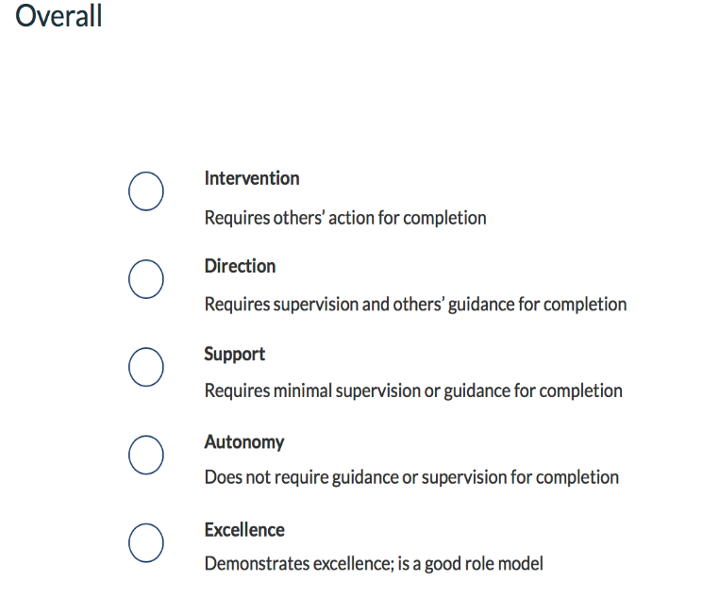
Good Comments
EPA CanMeds | Area of Observxn | Strengths | Areas for Improvement | Overall Entrust-ability
Collaborator | Chronic disease | Good skills of collaboration in coordinating care for patient with recent stroke. Ordered test that was missed at the hospital, and arranged F/U with patient | Try to pick up on pt's mood or affect during the visit- affect was noted to be flat, can always ask about mood, supports, feelings about recent stroke and possible cardiac conditions.
Professional | Not a patient encounter | Punctual, friendly, eager to learn during evening clinic at 80 Bond. Thank you for your diligence in checking in with locating to ensure there were no missed calls during a quiet night. | Keep up the great work!
Communicator | Disease with strong psychological component | Established excellent rapport as confirmed by patients wife Ascertained all concerns were addressed Patient centered, non judgmental, sensitive to $ issues | You spent a fair amount of time discussing the vaccines and the psychotherapy options. His request to then take meds for alcohol avoidance takes time for assessment and counselling, you may have wanted to defer that to a next appointment
FM Expert: Clinical Reasoning Skills | Acute self-limiting | Nice interview skills. Organized history. Nice rapport with patient. Good explanation of her plan with the patient. He had trust in her. | Continue to fine tune back exam- assessing for power and sensation is important at specific levels to assess disc issues due to leg dominant pain, fine tune straight leg raise exam. Know when to pursue special tests like Schober's if red flags present indicating possible inflammatory disease.
Support
Excellence
Autonomy
Direction
Notes:
This slide is set up so the audience can try and guess the level of Overall entrustability- if you don’t want to do that then remove the animation See how on slide 38

Slide 32
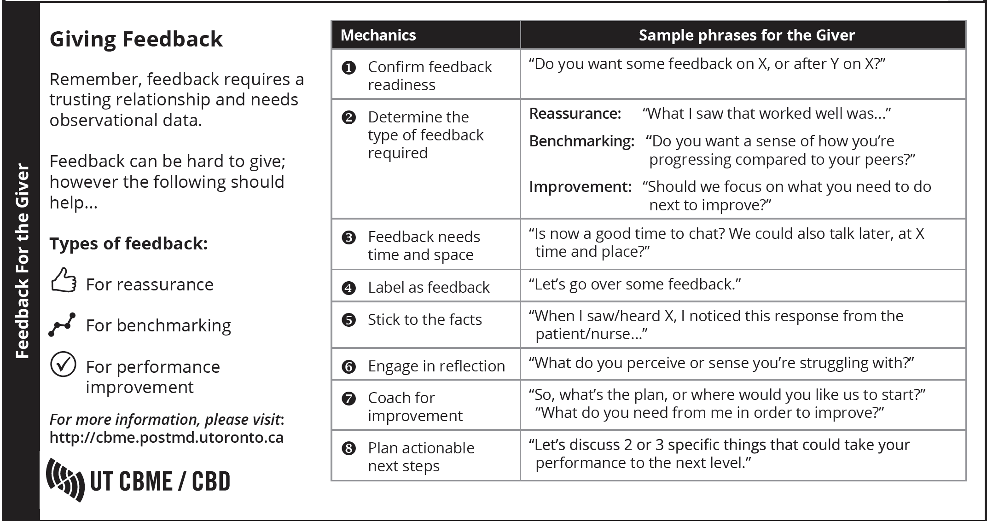
How to give effective feedback
Notes:
This document comes from a handout designed by Postgrad Medicine (all residency’s). It has 2 sides to it- A preceptor side to give constructive feedback and a Learner side to ask/accept it

Slide 33
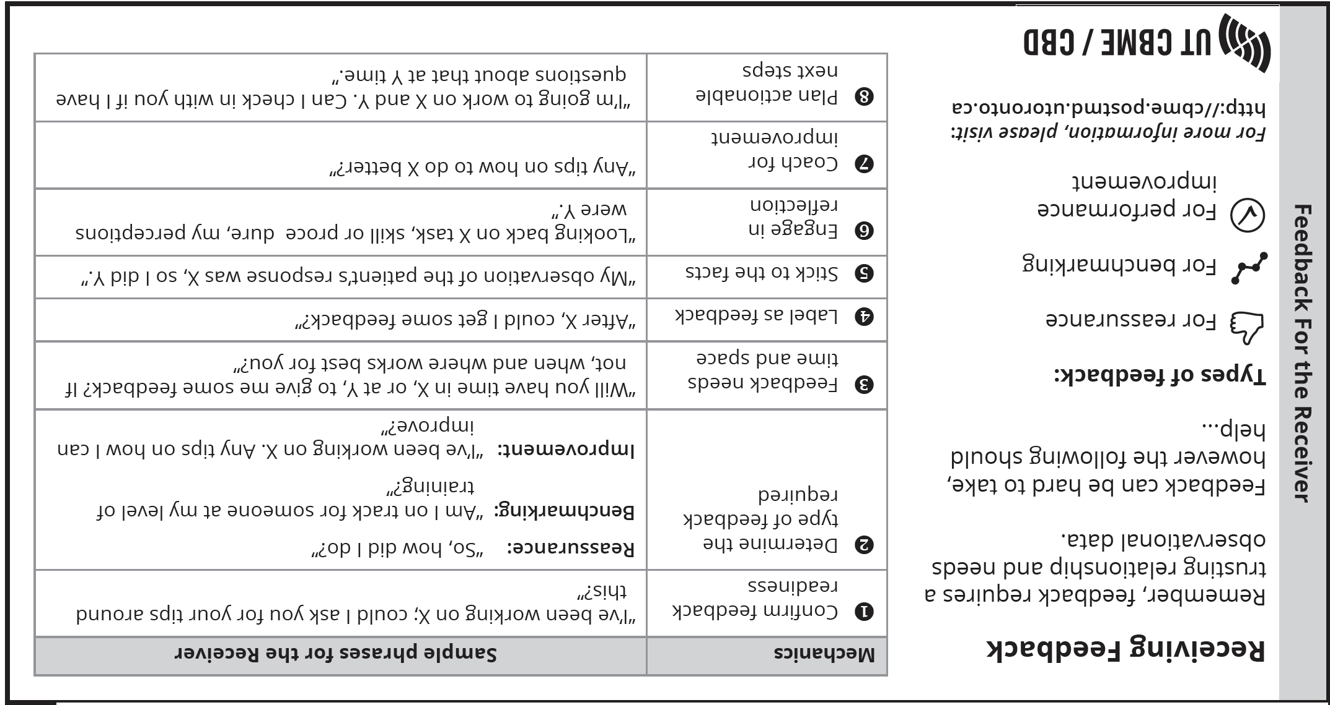
How to give effective feedback
Notes:
Here is the Receiver of feedback side

Slide 34
How to give effective feedback
Notes:
This is how the tool comes and can be folded as a pocket card

Slide 35
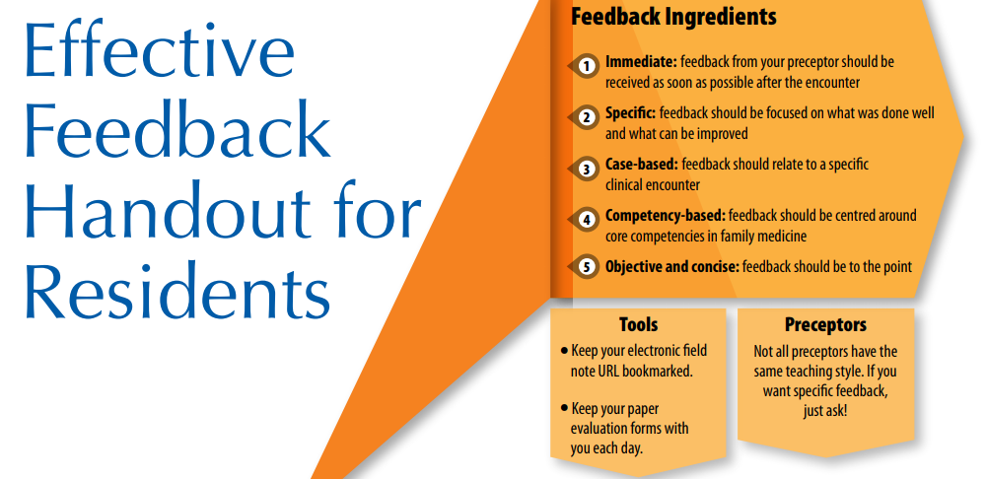
From CFPC
How to give effective feedback
Notes:
Optional slide: For residents 2 page tool Designed by Residents for Residents
https://www.cfpc.ca/uploadedFiles/Directories/Sections/Section_of_Residents/GIFT_HandoutforRes_ENG_RevMay18_Web.pdf

Slide 36
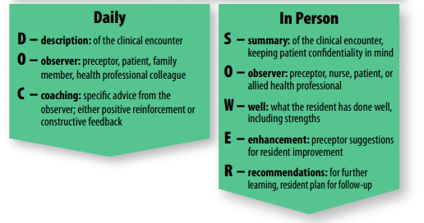
How to give effective feedback
Guide to Effective Feedback in Family Medicine Residency, May 2016

Slide 37
How to give negative feedback
Notes:
PD often hear that preceptors are reluctant to give low evaluations-the following are a video case and Tips slide to start the discussion. Are preceptors afraid of the consequences of negative feedback (poor evaluations of themselves by learners)? Does shielding learners really help?

Slide 38
Giving negative feedback
The next 2 slides can be used to practice how to give negative feedback using FN
-You can just do the video case/exercise or you can also add in the Giving Feedback slides as well if needed.
Play the video which is 2.5 minutes long
  -You will need speakers but NO internet is needed as the video is imbedded here
Have faculty work individually to fill out a FN on this encounter and then discuss in pairs or groups if time permits i.e. Think Pair Share if you have the time
You can use printed out on paper blank FN’s AND/OR complete one on your phone/computer on a real resident then delete
Consider reviewing slide 49 on what happens with negative FN’s
You can use the extra slides to discuss giving feedback in general

Slide 39
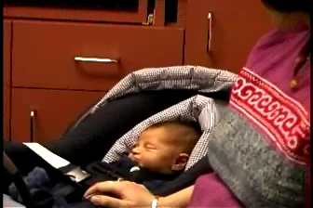
Notes:
Video is 2:33 minutes. Hover over the picture and the Progress bar will one Click on the left arrow to begin. WAIT for it to load
Note: the following scenario can be used to discuss how to do a field note when the learner didn’t do so well. In this scenario the learner has all the medical expert knowledge but isn’t able to collaborate with the patient’s mother.
Have the group watch the video and ideally everyone can fill out their own field note. You can use paper or a Resident in Elentra and then delete

Slide 40
Field Notes: Which approach is best?
DISCUSS
EPAs/CanMEDs
OVERALL LEVEL OF TRUST
1. What did the Resident do well?
2. What was not done well?
3. Which EPA (CanMeds)Why?
4. How to give negative feedback?
FM Expert
  Clinical Reasoning skills
  Patient Centered
  Procedures
  Selectivity
Health Advocate
Professional
Collaborator
Scholar
Communicator
Manager
Notes:
Start with leading the group in a discussion of how the resident did in general. What was done well, what was done poorly
Weakness: patient centered, collaborator, communicator
Strengths: Clinical reasoning, ? Health advocate for the baby
Then discuss which EPA (you can only pick one at a time but can do several field notes on the same patient encounter)
Then discuss Overall level of Trust

Slide 41
NOT A PROBLEM! It is a good way to document the following:
AN AREA FOR THE RESIDENT TO WORK ON
AN EVENT WHERE THE RESIDENT ACTED LESS THAN PROFESSIONAL
Not following up, not responding to emails, phones or tasks
Make sure you review with the resident in person
A REPEATED PATTERN
Same clinical mistake →time to document
What if there is a negative field note?
TRY TO STAY BALANCED
Did the resident do something well the same day?
Do a field note on that encounter too

Slide 42
Group Benchmarking
The next video scenario can be used as a group benchmarking exercise. It very helpful when you have several new faculty
Play the video which is 2.75 minutes long
-You will need speakers but NO internet is needed as the video is imbedded here
2. To save time and help with consensus focus on the FM Medical Expert Role EPA’s
(procedure is removed, you can do more EPA’s if you have time)
  Clinical Reasoning skills
  Patient Centered
  Selectivity
3. Have everyone decide on their overall field of competency for each of the 3 EPAs and compare

