Slide 1
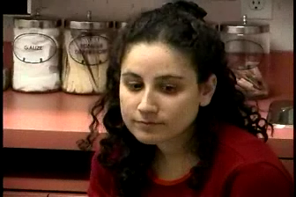
As you watch this video rate the resident on the Medical Expert EPA’s/CanMeds Role.
                Clinical Reasoning skills
                Patient Centered
                Selectivity
Notes:
Hover over the picture and the Progress bar will one Click on the left arrow to begin. WAIT for it to load

Slide 2
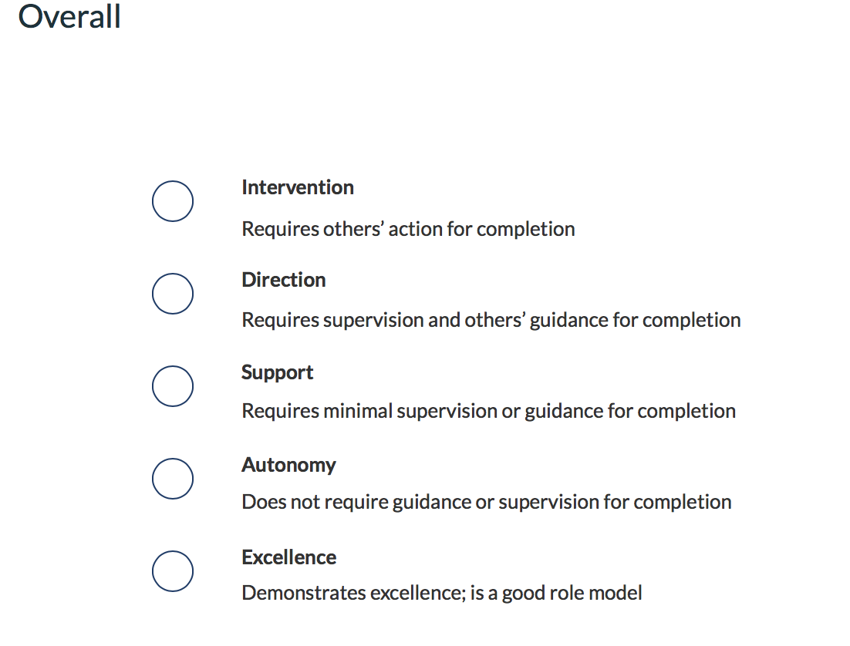
Field Notes: Which approach is best?
DISCUSS
EPAs/CanMEDs
OVERALL LEVEL OF TRUST
1. What did the Resident do well?
2. What was not done well?
3. Which EPA (CanMeds)Why?
4. How to give negative feedback?
FM Expert
  Clinical Reasoning skills
  Patient Centered
  Procedures
  Selectivity
Health Advocate
Professional
Collaborator
Scholar
Communicator
Manager
Notes:
The purpose of this exercise is to help Faculty compare their analyses to each other. Likely there will not be uniform consensus but ideally the OVERALL choice should only differ by 1 or 2 lines.
Begin by discussing what the Resident did well and then what was an area of weakness.
Weakness: Missed the fact she was bleeding, delved into their relationship maybe too early before rapport established
Strengths: Tried to engage the father early, collaborated well, elicited patient and partner’s ideas

Slide 3
The next 2 slides explain what an ITER is and how to complete- its very basic and aimed at sites that have Faculty who do not complete the ITERs themselves as an FYI only
Notes:
ITER- In training Evaluation Report - completed through POWER portal

Slide 4
What is an ITER?
IN TRAINING EVALUATION REPORT
ORGANIZED BY ASSESSMENT OF CANMEDS ROLE
2 OR BELOW FLAGGED FOR PROGRAM DIRECTOR AND SITE DIRECTOR TO DISCUSS AT RPRC
Notes:
ITER-In training Evaluation Report - completed through POWER portal
Completed at the end of a specialty rotation, block in FM and every 3 months in FM longitudinal

Slide 5
The ITER – CanMEDS roles
Range: not-competent → competent → proficient
4 ≠ the standard or average
Example below
Take an appropriately thorough history in a timely manner:
Notes:
Example of what an ITER looks like- many community doctors or junior faculty have never been responsible to fill it out.
Encourage Faculty to read the anchors and be honest

Slide 6

Putting it all together
The resident life cycle
Notes:
The following slides would be a visual representation of the process of evaluation of a resident, incorporating both Field Notes and ITERs which were previously discussed in the module

Slide 7



Field Notes
Additional Sources of Feedback:
ResPro
Presentations
Competency Meetings
Informal Feedback
ITER
First 3 months
Review with Preceptor
Notes:
This slide is meant to provide a visual overview of sources of resident feedback over a 3 month period. Ideally residents receive multiple field notes (remember, striving for 1 field note per half day). These field notes can then be used to inform the 3 month ITER prepared by the main preceptor. Other sources of feedback can also inform the ITER. These include feedback from other preceptors in competency meetings, informal feedback on residents, presentations that residents may be giving as well as the feedback the residents themselves provide in terms of type of patient encounters (ie. ResPro). Some preceptors may opt to meet with their resident prior to preparing the ITER. Others may complete the ITER first and then review with their resident.

Slide 8
0-3 months
4-6 months
Field Notes
Field Notes
ITER
Other Sources
ITER
Other Sources
FM-Map
PGCorED
Review with Preceptor
First 6 months
6 month review with Program Director
Notes:
Scaling up from the previous slide, we are now viewing resident evaluation over the first 6 months. Field notes and other sources of feedback continue to inform feedback to ITERs. The 3 month ITER and 6 month ITER in addition to other sources of feedback now informs the 6 month review with the Program Director. Program Directors have access to FM-MAP (FM Mandatory Assessment of Progress) and PGCorEd modules (central modules by Postgrad office). See one-pager for more explanations of terms.

Slide 9
Orientation
Month 1-6
Month 13-18
Month 19-24
Exit
CCFP Exam (SOOs and SAMPs)
Transition
Month 7-12
Competency database
Rotation objectives
ResPro
Competency database
Rotation objectives
ResPro
Competency database
Rotation objectives
ResPro
Competency database
Rotation objectives
ResPro
Competency database
Rotation objectives
ResPro
Competency database
Rotation objectives
ResPro
Resident
Resident and Faculty
Faculty
Field notes
ITARS
ResPro
Progress review
Field notes
Progress Review
YEAR1 PROMOTION
ITARS
ResPro
Field notes
ITARS
ResPro
Progress review
Field notes
GRADUATION
ITARS
ResPro
Field notes
ITAR (ITER)
Field notes
ITAR (ITER)
Field notes
ITAR (ITER)
Notes:
This slide scales resident evaluation up even higher to return to a 24 month overview of evaluation from three different perspectives.
Resident Perspective- responsibility for reviewing competence database, rotation objective and completion of ResPro
Resident and Faculty Perspective- Both involved in completion and review of Field Notes, ITERs and ResPro. Progress reviews informed by Field Notes/ITERS/ResPro/FM-MAP/PGCorEd
Faculty Perspective- Responsibility for completion of Field Notes on regular basis as well as ITERs (which are informed by Field Notes and other sources of feedback as discussed on previous slides)

Slide 10
Micro- Meso-Macro of Assessment
Micro
1:1 feedback in the form of field notes
Meso
  Feedback from field notes, ITERs, ResPro, Competency meetings informs regular progress reviews with preceptor
  6 month review with Program Director includes above plus FM-MAP, PGCorEd
Macro
  Collective feedback from above sources informs decisions regarding promotion from PGY1 to PGY2 and exit from residency
  License to Practice includes successful ITERs, PGCorEd, CCFP exams, MCCQE exams
Notes:
For another perspective on the varying levels of assessment, this slide provides an overview of assessment from more micro level i.e. 1:1 assessment (field notes) moving all the way to a more global, macroscopic assessment (i.e. decision re. ability for resident to be promoted or to graduate).

Slide 11
References
CFPC, Guide to Effective Feedback in Family Medicine Residency, May 2016 https://www.cfpc.ca/uploadedFiles/Directories/Sections/Section_of_Residents/GIFT%20Handout%20May%2020%20English.pdf
Dalhousie Family Medicine Residency Program: Characteristics of a Good Field Note and Field Note Use - Easy to follow instructions https://medicine.dal.ca/departments/department-sites/family/for-current-residents/resident-resources.html
Gofton, W., Dudek, N., Barton, G., and Bhanji, F. (2017). Workplace-Based Assessment Implementation Guide: Formative tips for medical teaching practice. 1st ed. (PDF) Ottawa: The Royal College of Physicians and Surgeons of Canada, pg. 1-12. Available at: Royal College of Physicians and Surgeons
http://www.royalcollege.ca/rcsite/documents/cbd/wba-implementation-guide-tips-medical-teaching-practice-e.pdf and
Entrustability Scales: WBA Rating Anchors to Trust, Royal College Module http://www.royalcollege.ca/mssites/entrustability/index.html#/?_k=b2ozqk
Leung, Fok-Han. Field notes – updates and enhancements. Presentation to RPC – Dec 2018
“Miller’s Pyramid of Clinical Competence,” by R. Mehay and R. Burns, 2009. In R. Mehay (Ed.), The Essential Handbook for GP Training and Education (chapter 29: Assessment and Competence, p414). Also available at: http://www.essentialgptrainingbook.com/chapter-29.php.

Slide 12
Contributors
Thank-you
Risa Bordman
Gemma Cox
Susan Goldstein
Michelle Homer
Fok-Han Leung
Jennifer McDonald
Peter Tzakas
Nina Yashpal

