Slide 1
Competency-Based Curriculum - Faculty Awareness Module
Module Developers:
Cary Fan, Eleanor Colledge, Robert Gabor, Batya Grundland, Eva Knifed, Giovanna Sirianni
Notes:
Speakers Notes: Recommend that participants use their laptop or tablet to log into the curriculum and refer to it throughout the presentation. This session is intended to be interactive

Slide 2
Objectives
Review basics of the Triple C Competency Based Curriculum
Review how the curriculum is mapped to the CanMEDs-FM roles
Utilize cases to highlight approaches to incorporating the curriculum and competencies into day-to-day supervision
Provide resource links for faculty

Slide 3
Triple C Curriculum
Triple C Curriculum = Competency-Based Curriculum
Comprehensive, Continuity, Centered in family medicine
Based in CanMEDS-FM and Evaluation Objectives for Family Medicine
Frank JR, Snell L, ten Cate O, HolmboeES, CarraccioC, Swing SR, et al. Competency-based medical education: theory to practice. Med Teacher. 2010;32:638-45; CFPC Triple C Toolkit
Notes:
Speakers Notes: Currently, Royal College Programs are undergoing transformation to Competency By Design (CBD). It is worth noting that family medicine introduced Competency Based Medical Education (CBME) in Canada before any speciality programs did. This is something family physicians should be very proud of. What does Triple C Stand for:
Comprehensive education and patient care
Continuity of education and patient care
Centred in family medicine
Background Information (Optional): “Triple C ensures all graduates are:
Competent to provide comprehensive care in any Canadian community
Prepared for the evolving needs of society
Educated based upon the best available evidence on patient care and medical education
This curriculum addresses accountability, social responsibility, patient safety, and efficiencies in educational programming. It highlights the College’s vision of graduating sufficient numbers of Canadian family physicians who can provide comprehensive, continuing care within traditional family practices and within newer models of interprofessional practice.”
Slide adapted from: https://www.cfpc.ca/uploadedFiles/Resources/Resource_Items/Triple_C/2%20Key%20Concepts%20and%20Definitions%20of%20Competency-based%20Education.pdf

Slide 4
Triple C Curriculum
Competence: “Is the array of abilities across multiple domains or aspects of physician performance in a certain context… Is multi-dimensional and dynamic… Changes over time, experience, and setting”
Frank JR, Snell L, ten Cate O, HolmboeES, CarraccioC, Swing SR, et al. Competency-based medical education: theory to practice. Med Teacher. 2010;32:638-45; CFPC Triple C Toolkit
Notes:
Speakers Notes: Read the definition of competence on the slide.
Another way of explaining competence: “Doing the right thing at the right time in the right way in complex situations.”
Example of what competence would look like in a clinical scenario: Being able to construct an appropriately thorough differential diagnosis related to common symptoms that is congruent with the data generated by the history and physical and weighted according to probability. Demonstrate evidence based knowledge of the common diagnoses in creating a differential diagnosis (FAM 06)
Background information (Optional): Competence = Integration of knowledge, skills, attitudes, values within a specific context
Slide adapted from: https://www.cfpc.ca/uploadedFiles/Resources/Resource_Items/Triple_C/2%20Key%20Concepts%20and%20Definitions%20of%20Competency-based%20Education.pdf

Slide 5
Notes:
Speakers Notes: Competency-Based Medical Education (CBME) has 4 main cornerstones:
Frequent, direct observation of learners. The observation of learner actions/behaviours in a clinical and workplace context is critical to ensuring the achievement of competence.
Hand-in-hand with direct observation in a workplace environment comes feedback provision to encourage i) behaviours to be reinforced ii) areas for improvement iii) an action plan for next steps in the longitudinal attainment of competence.
Documenting this feedback through frequent, low stakes assessments, like Field Notes, is important to help develop a narrative of resident attainment of competence. Field Notes can be used to inform high-stakes assessments, like end-of-rotation ITERs.
Coaching: Part of helping residents attain competence is providing individualized, longitudinal feedback to help them achieve competence in their program over time. This would be analogous to a coach for a sports team or musician.
Background information (Optional): Coaching is “[different] from traditional tutelage in that it does not focus on knowledge transmission. [Different] from mentorship in that it does not focus on advice and counselling. Coaching requires the provision of contemporaneous and individualized feedback on observed behaviour, and the use of stimulating and challenging observations to maximize the coachee’s full potential” (Lovell, 2018) (p. 377).

Slide 6
Where can I find the DFCM PostGrad Curriculum?
DFCM Website under curriculum tab: http://www.dfcm.utoronto.ca/curriculum
Quercus (need UTorID and password)
For mapping to CanMEDS Roles
Site specific curriculum mapping to specific rotations
Notes:
Speakers Notes: Suggest that participants log into the curriculum. Suggest that speakers demonstrate the two different ways of looking-up the curriculum: PDF vs Web application. Speakers should also ensure all faculty have access. Please keep track of faculty who do not have access and ask your program administrators to contact the postgrad program so that access to the curriculum can be facilitated .

Slide 7
DFCM Curriculum
Competency-Based
- Entrustable Professional Activities of Family Medicine
- Domain Specific (Maternity care, MSK, Emergency Medicine, Palliative Care etc.)
Mapped to the CanMEDS roles
Language used in ITERS and Field notes is based on this curriculum
Notes:
Speakers Notes: Recommend audience members follow along with the curriculum on their own devices (suggest laptop or a tablet) while the session leads demonstrate. Keep the curriculum open as it will be used throughout the presentation.
What is an EPA? (EPA = Entrustable Professional Activities of Family Medicine): EPA=The key tasks required of a family physician (i.e. The ‘how’ and ‘what’ of being a family doctor)
Domain specific competencies are more specific to content areas. The list of competencies has overarching competencies and underneath are “enabling competencies” which are sub competencies that explain what a resident needs to know to achieve the overarching competency
ITERS are Power evaluations
Background Information:
Examples:
EPAs of family medicine:
FAM01. Understand the role of a generalist physician in the health care system. (Mapped to all of the CanMEDS roles) other than scholar
FAM02. Take an appropriately thorough history in a timely manner. (mapped to Communicator and Medical Expert)
FAM03. Display effective, professional and non-judgmental communication skills. (Mapped to Communicator and Collaborator)
Domain Specific: Maternity Care:
MAT03. Perform routine antenatal visits independently at appropriate intervals based on gestational age.* (Mapped to FM Expert, Collaborator, Communicator)
MAT04. Provide counseling with respect to medication use in pregnancy, with or without pharmacy assistance. (Mapped to FM Expert, Communicator, Collaborator)
MAT05. Collaborate with other health care professionals based on identified risk factors (i.e. dietician, psychiatry, obstetrics) (Mapped to FM Expert adn Collaborator)
MAT06. Assess common presentations in triage*. (FM Expert, Communicator)
MAT07. Manage a patient through labour and delivery with supervision. * (FM Expert, Communicator, Health Advocate)

Slide 8
Notes:
OPTIONAL
Speakers Notes: The Fundamental Teaching Activities Framework (FTA) is a comprehensive document that allows the “opportunity to reflect on our roles as teachers.” The FTA helps to describe the work that teachers are already doing.
Clinical Coach = Describes your role in day-to-day practice in the supervision and support of residents in the workplace
Competency Coach = The Competency Coach (as described on the previous slide) is someone who is an advisor to the residents over the course of their residency. At most sites, the Site Director is in this role. [If your site has another individual(s) as the Competency Coach(es) please discuss it at this point.]
Background Information: The FTA Framework: Describes what teachers actually do and helps them to consider creative ways to expand and enhance their teaching activities.
Outlines a clear description of essential tasks for teachers in family medicine
Provides a road map to guide self-reflection and continuing professional development
Assists programs, departments and faculty members in developing strategies for faculty development
Serves as an organizational framework for family medicine faculty development materials, tools, and strategies, both locally and nationally
Contributes to the field of faculty development in medical education

Slide 9
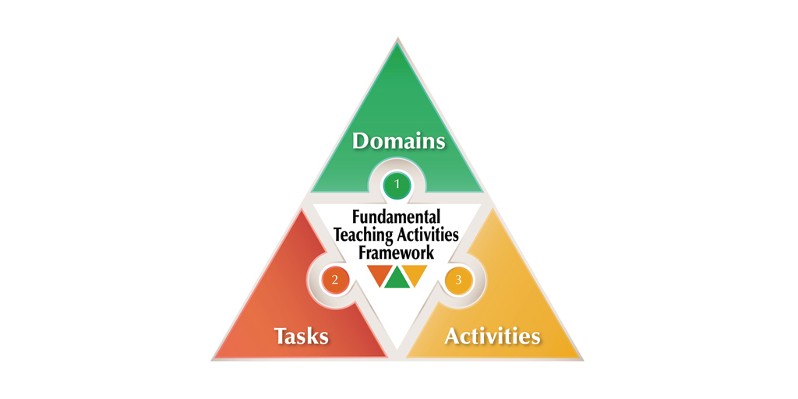
Fundamental Teaching Activities Framework (FTA)
Notes:
Speakers Notes: The Fundamental Teaching Activities Framework (FTA) defines our roles as teachers and coaches in family medicine. As a teacher, the FTA framework are your rules for engagement, and define how we as teachers should operate.
Background information: We are competent teachers if we operate using the FTA framework.

Slide 10
Clinical Preceptor
embodies roles, attitudes
of a family md
gives timely learner centered feedback
promotes and stimulates clinical reasoning and problem solving skills
Clinical Coach
Your best Preceptor!
Competency Coach
Notes:
Speakers Notes: As a family doctor heads into clinical supervision of a learner, part of your role as a preceptor is as a clinical coach, as outlined by the FTA. Your tasks as the clinical coach include 1) embodying the roles and attitudes of a family doctor 2) give timely learner, centered feedback 3) promote and stimulate clinical reasoning and problem solving skills
The role of the clinical coach will be considered in case 1

Slide 11
Case 1

Slide 12
Case 1
A 69 year old otherwise healthy man with a history of “bad knees”
- Fall one year ago and cut back on activities due to progressive pain
- Failed physio due to pain, minimal benefit from OVC analgesics
- Medial joint line tenderness and an antalgic gait
- Resident diagnosis osteoarthritis and a suspect meniscal tear
- They want to get an MRI and send to ortho for opinion
After discussion with you, the plan is to get weight bearing X rays and initiate a referral to local OA program (GLA:D), with a plan for consideration of steroid injection. Deferred ortho consult with no MRI.
Notes:
Speakers Notes: Present case first. Poll audience - What do you see as 2-3 competencies that you would like to highlight/teach in this case? Audience should go to the curriculum and look it up for themselves. Audience to identify some relevant competencies. Not everyone will choose the same competencies for this case. Emphasize that this is a flexible approach to which teaching points you would like to emphasize in a learner encounter.
Your knowledge and experience tells you what the management plan should be, but where is this written, and how do you backup what you are doing?

Slide 13
How does this case relate to the EPAs for family medicine?
Notes:
EPA = Entrustable Professional Acitivites

Slide 14
Entrustable Professional Activities in Family Medicine pg 3
FAM19. Participate effectively in collaborative practice, including appropriate referrals and consultations.
19A...
19C. Refer patients if they fail medical management, present beyond personal scope, or if surgical consultation is warranted and construct a meaningful referral letter.
19D. Engage appropriate health providers and community resources.
Musculoskeletal Health pg 32
MSK06. Construct an appropriately thorough differential diagnosis that is congruent with the data generated by the history and physical.
6A. Select appropriate diagnostic investigations (i.e. radiography, ultrasound and MRI), if required, to support or refute differential diagnosis
6B. Interpret...
DFCM COMPETENCY BASED CURRICULUM AT A GLANCE
JUNE 2019
Notes:
Speakers Notes:
Refer to the DFCM Competency Based Curriculum. This is what you are basing your teaching on. Examples of potential competencies that can be emphasized are outlined on the slide.
You can select 2 competencies for the DFCM curriculum to base your decision and teaching on:
Entrustable professional activities section, where it talks about appropriate referrals. You are not referring because they have not failed medical management, and you have not engaged appropriate community resources
Musculoskeletal health: section 6A-select an appropriate diagnostic investigation

Slide 15
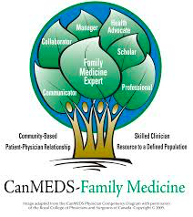
How does this case speak to the CanMeds Roles?
Image from the CFPC’s CanMEDS – Family Medicine: Working Group on Curriculum Review​

Slide 16
Four Principles
Community-Based
Patient-Physician Relationship
Skilled Clinician
Resource to a defined population

Slide 17
CanMEDS-FM expert role: Collaborator
Participating in collaborative team-based models of care and interprofessional health care teams
The family physician as community-based
Management of scarce resources and understanding of the health care system
Image from the CFPC’s CanMEDS – Family Medicine: Working Group on Curriculum Review​
Image from the CFPC’s CanMEDS – Family Medicine: Working Group on Curriculum Review
Image from the CFPC’s CanMEDS – Family Medicine: Working Group on Curriculum Review
Notes:
Speakers Notes:
So how are you ensuring competency based on the CanMEDS-FM expert role?...you identify the skills as a collaborator:
- knowledge and utilization of services within your community, and managing scarce resources (our specialists as well as MRI time), not referring prematurely and avoiding expensive investigations that are not needed.
- You identify this as part of the 4 principles the canMEDS-FM roles are based, being community based, having the skills to make the right decision, and being a resource to your patients

Slide 18
CanMEDS-FM expert role: Manager
Contributing to effectiveness in health care systems
Practice and career management, and effective use of resources
Four Principles
Community-Based
Patient-Physician Relationship
Skilled Clinician
Resource to a defined population
Notes:
Speakers Notes:
So how are you ensuring competency based on the CanMEDS-FM expert role?...you can also highlight their role of a manager:
-the health care system operates more effectively with appropriate referrals that are already worked up making it more effective
-your specialist colleagues will look more favorably upon you and your future consults, knowing you do good work
You identify this as part of the 4 principles the canMEDS-FM roles as now you are a skilled clinician, and by doing this for them you have built a better patient physician relationship instead of being the “referral doctor”

Slide 19
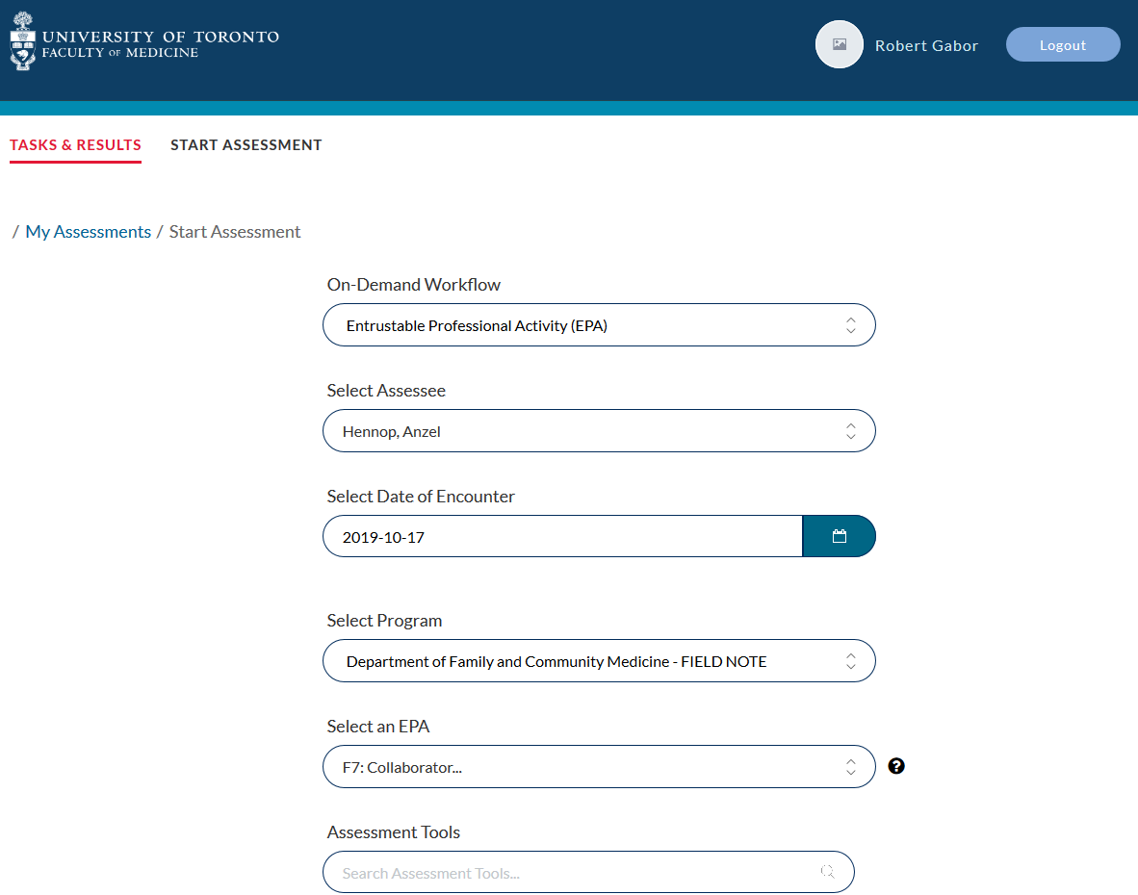
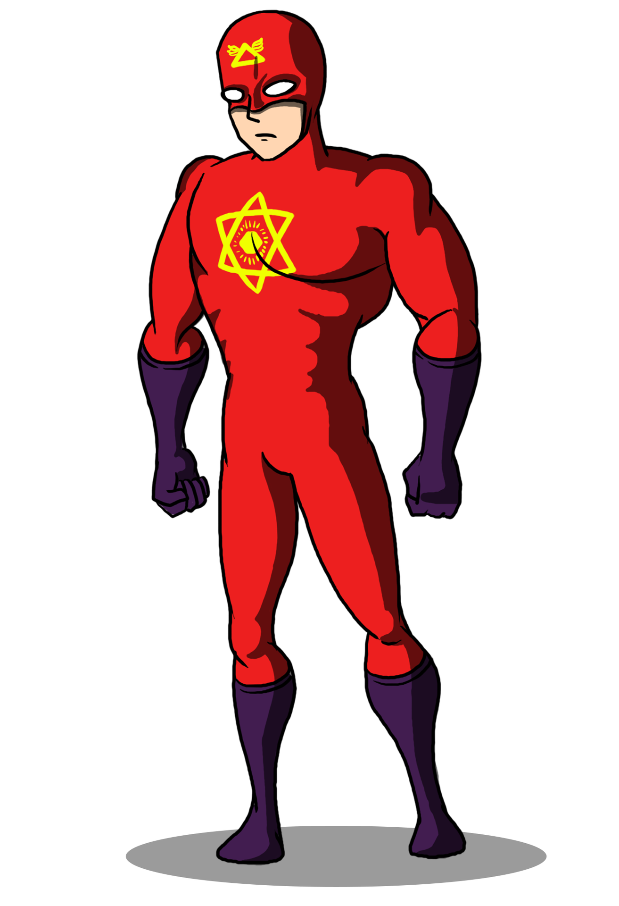
Pete Mitchell
Notes:
Speaker Notes: Now your next step in being a real superhero is filling out a field note on this feedback using the CanMED-FM role as a Collaborator as the EPA.

Slide 20
Clinical Preceptor
Utilizes
appropriate
educational
framework to
explicitly articulate
decisions and actions
Clinical
Coach
Notes:
Speakers Notes:
In the end you can reflect back on what you have done today as your role as a preceptor. You have completed what you set out to do, as a clinical coach you have utilized an appropriate educational framework (the CFPC Competency Based Curriculum) to explicitly articulate decisions and actions, You used the FTA to articulate your role with as a resident preceptor.

Slide 21
Case 2

Slide 22
Medical Expert
“Mrs. Y is a 75 year old woman who was admitted for a Right basal ganglia stroke two days ago.
We captured an irregularly irregular rhythm on telemetry. I would like to counsel her about this new diagnosis and propose treatment.”
Notes:
Speakers Notes: Present case first. Poll audience - What do you see as 2-3 competncies that you would like to highlight/teach in this case? Go to the curriculum and look it up for themselves. Audience to identify some relevant competencies. Not everyone will choose the same competencies for this case. There is a flexible approach to which teaching points you would like to emphasize for a particular learner encounter.
The curriculum maps similarly in domains outside of the office, and when it comes to the Medical Expert role, chances are you are already demonstrating this in day-to-day practice. What kinds of things could you talk to your resident about with respect to this case?
(Some possibilities from the participants might include:)
[In-Patient Competencies HOS01]
Interpreting a test correctly: did they really see atrial fibrillation? Do they understand the concept of rate control?
Adopting a patient-centred approach to management: assessment of stroke vs bleed risk, patient fears and values
Developing an appropriate treatment plan: do they understand therapeutic options
Identifying when patients need critical support: do we need subspecialist support?
Communicate effectively with patients throughout their hospitalization
[Care of the Elderly Competencies]
Manage medications in the elderly effectively [COE10]
[Background only: The goal of this case is to illustrate how the Medical Expert and Scholar roles are embedded in our daily interactions with patients in the diagnosis and treatment of disease, regardless of the domain.]

Slide 23
Scholar
“... so, which anticoagulant do you like to use?”
Do you incorporate new therapeutic options into your clinical decision making?
Notes:
Speakers Notes:
And of course, the resident wants to know what YOU would do!
(Whatever the answers, we demonstrate the awareness of the need to become a lifelong learner [FAM20], and the ability to incorporate feedback into learning and practice [FAM22E].)
Poll the audience for their suggestions:
Do we pick treatment always based on the most recent evidence?
[FAM20A]: employ whenever possible the principles of evidence-based medicine
Do we select on the basis of your most recent bad outcome?
[FAM20E] follow-up on cases to learn from both good and bad patient outcomes
Do we sometimes select older drugs because we are comfortable with their risk profile? (and avoid being early adopters?)
If you’ve taken the time to research or read about something [FAM20D - develop basic skills in research and scholarly inquiry], and share with your findings with your residents or colleagues, you’re modeling responsible practice and life-long learning [FAM20].

Slide 24
Case 3

Slide 25
Case 3
Mid-PGY-1 resident
You’ve observed that their clinical skills and communication skills are quite good with typical “medicine” problems
Notes:
Speakers Notes: Case details: You are one of the main supervisors of this resident and have been supervising them regularly. Even though family medicine was their back up they are overall enjoying the program now and have no intentions of switching programs. They want to do well and learn to become a good family physician
Background information: This case is an axample of applying domain specific competencies in general family practice setting

Slide 26
Case 3
Seems to be struggling with patients who present with mental health concerns
Gets uncomfortable, sometimes sighs and rolls eyes in the consult room
Limited differential diagnosis and treatment options
Refers early for counselling or psychiatric assessment
Notes:
Speakers Notes: Present case first. Poll audience - What do you see as 2-3 competencies that you would like to highlight/teach in this case? Go to the curriculum and look it up for themselves. Audience to identify some relevant competencies. Not everyone will choose the same competencies for this case. There is a flexible approach to what you would like to emphasize in a teaching encounter

Slide 27
Case 3
How could you use the curriculum to help guide the discussion regarding their approach to patients with mental health concerns?
How could you use the curriculum to help guide the resident regarding their professional identity formation as a family physician?
Notes:
Speakers Notes: How could we use the curriculum to help guide the resident’s approach to mental health? Open for discussion. One approach could be to sit down with the resident and review the mental health competencies and the professionalism competencies. What is the resident’s action plan/what areas would they like to work on?
Re: mental health, can go to either of the curriculum documents to discuss what is expected for our residents to learn and be able to do in terms of mental health (there are a lot of competencies for this so this is a big part of our practice)
Together some competencies could be chosen as learning goals and objectives for the resident to read about and focus on to practice (setting goals and objectives)
The first one is mapped to professionalism “to utilize the competencies of a family physician in addressing mental health concerns”—what does it mean to be a family physician for patients with mental health concerns
Or could go to the entrustable professional activities of family medicine –understand the role of the generalist physician in our health care system—and discuss this with regards to mental health
-or the one on reflective practice
Specifics of how a teacher would use this to guide the discussion. Step-by-step guide of how to find the curriculum:
Step #1: Go with the resident to the curriculum documents (either PDF on the website or log in to Quercus) dfcm.utoronto.ca, click on Curriculum tab
Step #2: Look at the mental health competencies together (both to illustrate what is expected of the resident by the end of their residency and to decide on some learning goals moving forward)
Step# 3: Choose 2 or 3 competencies in the area of mental health eg. PSY02. Perform an appropriate history and physical examination and order diagnostic tests to generate a differential diagnosis of medical conditions causing or contributing to psychiatric presentation for common axis 1 disorders. , PSY03. Generate a differential diagnosis and make a diagnosis using Diagnostic and Statistical Manual of Mental Disorders (DSM) criteria for common mental health disorders (list disorders (requires knowledge of DSM criteria) or make referral to clarify diagnosis where presentation is complex. PSY11. Provide continuity of care.PSY12. Initiate and manage common pharmacologic treatments.
PSY13. Initiate common non-pharmacologic treatments for depression, anxiety disorders, bipolar
By choosing a few competencies, this can guide the resident where to focus their learning and a point to see if they are moving forward to meet their goals.
Step #4: Come back to these in the future to see if resident has met the mark. More importantly, remind resident where, as they work to improve their skills in mental health, where they can go to review the curriculum and see what the expectations are.
Re: Professionalism-similar to above--and in real life would be done in combination:
Example competencies that may be reviewed with resident:
FAM01. Understand the role of a generalist physician in the health care system
FAM03. Display effective, professional and non-judgmental communication skills.
FAM11. Demonstrate an effective approach to the presentation of illnesses with a strong psychological component.*
11G. Employ the therapeutic power of the doctor-patient relationship in the patient’s illness experience and recovery.
11J. Commit to the follow-up and care of patients with psychological and psychosomatic illness.
PSY01. Utilize the competencies of a family physician in patients with mental health concerns.
After the discussion is had with the resident, a component of this could easily be put into a field note.

Slide 28
Macro-Meso-Micro of Curriculum
MACRO: CFPC Triple C Curriculum
MESO: DFCM has a competency-based curriculum rooted in Triple C
MICRO: Specific competencies can help guide resident learning throughout the program

Slide 29
Quiz
What are the four components of competency-based medical education?
Where can you find the DFCM Curriculum? How is it organized?
Describe one way in which you can use the DFCM Curriculum when teaching residents?

Slide 30
References and Resources
DFCM Curriculum:
http://www.dfcm.utoronto.ca/curriculum
Triple C Curriculum:
https://www.cfpc.ca/TripleCToolkit/
Fundamental Teaching Activities Toolkit:
https://www.cfpc.ca/fundamental-teaching-activities/
Notes:
? Resources

Slide 31
Optional Slides

Slide 32
How do the CanMEDs Roles Map to the Four Principles of Family Medicine?
Notes:
OPTIONAL

Slide 33
CanMeds-FM
Image from the CFPC’s CanMEDS – Family Medicine: Working Group on Curriculum Review​
Notes:
Speakers notes:
Focus on how CanMeds fit into the principles of family medicine and how this is used in the competency based curriculum

Slide 34
The family physician is a skilled clinician…
CanMeds roles:
•Medical expert
•Communicator
•Professional
•Scholar
Image from the CFPC’s CanMEDS – Family Medicine: Working Group on Curriculum Review​​
Notes:
Speaker notes:
Ask participants to brainstorm which CanMeds roles fit under this principle of family medicine
*answers will appear when you click*
Briefly discuss how each CanMeds role applies to the family physician as a skilled clinician
Medical expert - this is central to the role of the physician in general and applies to family medicine equally
Communicator - part of being a skilled clinician is the ability to communicate well with patients, families, other physicians, other healthcare workers etc
Professional - the professional integrity of the clinician is an important part of their identity as a skilled clinician. An unprofessional individual is not likely to be appreciated or respected for their skills no matter how good they are
Scholar - this goes hand in hand with the medical expert but this is an opportunity to highlight the academic work that many family physicians choose to do

Slide 35
Family medicine is a community based discipline…
CanMeds roles:
•Healthcare Advocate
•Manager
•Collaborator
•Communicator
Image from the CFPC’s CanMEDS – Family Medicine: Working Group on Curriculum Review​​​
Notes:
Speaker notes:
Ask participants to brainstorm which CanMeds roles fit under this principle of family medicine
*answers will appear when you click*
Briefly discuss how each CanMeds role applies to family medicine as a community based discipline
Healthcare Advocate - family physicians are important advocates for their patients to receive services and resources that are necessary to for their health and wellbeing
Manager - family physicians are managers of their patients care within their communities. They help to coordinate care. Also, they are respected and have a strong voice in shaping the community
Collaborator - family physicians do not work alone even when they are solo practionners in theirs own offices. They work other physician colleagues, allied health workers, and even government agencies such as cancer care ontario and the ministry fo health
Communicator - this role comes up in many principles of family medicine because it such an important part of being a family physician. Communication is key to being a great member of a community

Slide 36
The family physician is a resource to a defined practice population…
CanMeds roles:
•Healthcare advocate
•Communicator
•Collaborator
Image from the CFPC’s CanMEDS – Family Medicine: Working Group on Curriculum Review​​​
Notes:
Speaker notes:
Ask participants to brainstorm which CanMeds roles fit under this principle of family medicine
*answers will appear when you click*
Briefly discuss how each CanMeds role applies to the family physician as a resource to a defined population
Healthcare advocate - family physicians are central advocate for their patients in ensuring that they receive the right services to ensure their health and well being
Communicator - a central part of being family physician. It’s difficult to be a resource without good communication skills
Collaborator - part of how family physicians are resources for their patients is as collaborators in healthcare with other physicians, allied health professionals, government agencies, pharmacies etc

Slide 37
The patient-physician relationship is central to the role of the family physician…
CanMeds roles:
•Communicator
•Collaborator
•Professional
•Healthcare advocate
Image from the CFPC’s CanMEDS – Family Medicine: Working Group on Curriculum Review​​​
Notes:
Speaker notes:
Ask participants to brainstorm which CanMeds roles fit under this principle of family medicine
*answers will appear when you click*
Briefly discuss how each CanMeds role applies to the patient-physician relationship is central to the role of the family physician
Communicator - central to the patient-physician relationship. Good communication is essential for building a strong patient-physician relationship
Collaborator - family physicians collaborate with their patients to help them achieve excellent health and collaborate with other members of the healthcare team to ensure their patient is well looked after
Professional - the professional conduct of the family physician forms a key element of the patient-physician relationship
Healthcare advocate - the family physician as an advocate for their patient forms a central part of the patient-physician relationship whereby the patient entrusts their family physician to advocate on their behalf for the best possible care

