Slide 1
Fostering Wellness, Resilience & Safety in our Learners, in Ourselves
Faculty Development Module 2019-2020
M.Roberts, M. Markovski, D.Vlahos, M.Ivankovic

Slide 2
Wild Geese
You do not have to be good.
You do not have to walk on your knees
for a hundred miles through the desert repenting.
You only have to let the soft animal of your body
love what it loves.
Tell me about despair, yours, and I will tell you mine.
Meanwhile the world goes on.
Meanwhile the sun and the clear pebbles of the rain
are moving across the landscapes,
over the prairies and deep trees,
the mountains and the rivers.
Meanwhile the wild geese, high in the clean blue air,
are heading home again.
Whoever you are, no matter how lonely,
the world offers itself to your imagination,
calls to you like the wild geese, harsh and exciting
over and over announcing your place
in the family of thing
-Mary Olivers
Photo by Tim Umphreys on Unsplash
Notes:
Wildgeese Slide 1
Intention of the poem is to set a tone for the session about personal and professional wellness and resilience
Facilitator does not have to present the poem, can move into slides 2 and 3 on definitions of wellness and resilience
If you use the poem- have one person read it to the group
Leave a moment for reflection
Facilitating questions:
What struck you about the poem? Why?
Anything that you liked? Spoke to you?
Why do you think we chose this poem for this wellness session?
This is an opening activity for the session to help shift the mood from work. Feel free to substitute the activity to suit your site. Activity is to read the poem, and ask the participants how they are responding, and what does this say to them regarding wellness and resilience?

Slide 3
“Wellness is a state of complete physical, mental and social well-being, and not merely the absence of disease or infirmity”
World Health Organization
Image by Elias Sch. from Pixabay

Slide 4
“Resilience is defined as the set of individual skills, behaviours, and attitudes that contribute to personal physical, emotional, and social well being
– including the prevention of burnout”
Bohman B, DyrbyeL, Sinskyn CA et al. Physician Well-Being: The reciprocity of practice efficiency, culture of wellness, and personal resilience. NEJM Catalyst 2017
Image by Johannes Plenio from Pixabay
Notes:
What is resilience? This slide defines it according to the World Health Organization
“Burnout is a pervasive problem among physicians.¹ The burnout syndrome is characterized by losing enthusiasm for work (emotional exhaustion), treating people as if they were objects (depersonalization), and having a sense that work is no longer meaningful (low personal accomplishment).² Numerous global studies
involving nearly every medical and surgical specialty indicate that approximately 1 of every 3 physicians is experiencing burnout at any given time. (Tait Shanefelt, JAMA. 2009;302(12):1338-1340. doi:10.1001/jama.2009.1385)

Slide 5
Objectives:
At the end of this session participants will be able to:
Describe the ingredients for Safety and Wellness
Describe what is Resident and Physician Safety, Wellness & Resilience
Identify strategies to promote Resident, Teacher, Administrator Wellness in the learner environment
Integrate wellness interventions into a residency curriculum
Notes:
Objectives of the Module are listed

Slide 6
Standards of Accreditation for Residency Program in Family Medicine
5: Safety and wellness are promoted throughout the learning environment.
5.1: The safety and wellness of patients and residents are actively promoted.
5.1.2.1: Safety is actively promoted throughout the learning environment for all those involved in the residency program.
5.1.3: Residency education occurs in a positive learning environment that promotes resident wellness.
7.1.2.5: The residency program promotes and supports resiliency and well-being for their teachers.
Notes:
These are the standards outlined in the Red Book – take note, these are the standards for the accreditors.

Slide 7
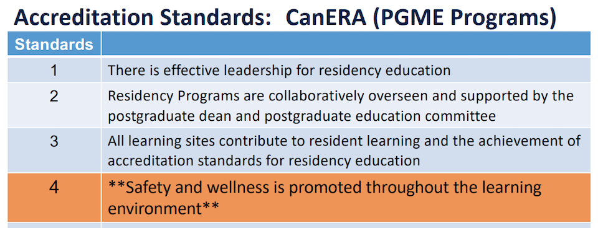
Notes:
Please look up: https://cacms-cafmc.ca/ and http://www.canera.ca/canrac/general-standards-e and http://www.royalcollege.ca/rcsite/accreditation-pgme-programs/accreditation-residency-programs-e to help with understanding of what is expected of us for this accreditation.

Slide 8
Resident Wellness Guideline:
"Ensure a safe work environment absolutely free from intimidation and harassment, and in which residents are able to freely communicate their wellness needs”
"Be cognizant of factors that affect resident wellness; take steps to ensure the safety of learners when health or fatigue may be affecting a trainee”
(https://pg.postmd.utoronto.ca/wp-content/uploads/2019/11/PG-Wellness-Guide lines_Nov2019_PGMEAC_final.pdf)
Notes:
PostGrad has developed Wellness Guidelines. Available upon request – email : familymed.postgrad@utoronto.ca
These references are stemming from the Learner Mistreatment report.
The reported level of learner mistreatment is a significant ongoing problem and will impact the 2020 accreditation of both the MD and PostMD program.
Learner Mistreatment Report - 42% of Family Medicine Residents have experienced discrimination at least once in the past academic year (disrespectful behaviour, verbal assault, sexism, racism, anti-semitism, islamophobia, pregnancy related)
Perpetrators include faculty, patient/family members, other learners, nurses, other allied health or staff)
Provide a safe environment that enables students to comfortably express concerns about wellness and to report fatigue-related incidents with no consequence to the resident

Slide 9
Learner Mistreatment:
Learner Mistreatment Report : 42% of Family Medicine Residents have experienced discrimination at least once in the past academic year (disrespectful behaviour, verbal assault, sexism, racism, religious persecution, and pregnancy related)
Notes:
Data from the Learner Mistreatment report (see references and resource slides) These stats show the current state of the FoM., DFCM.

Slide 10
Strategic initiatives :
Optimizing the Learner Environment
Faculty Wellness
Director of Professional Values
Programs to strengthen Diversity, Equity and Inclusion
Notes:
Taken from the Learner mistreatment report – the shift on how to optimize Learning environment

Slide 11
Notes:
Taken from the Learner Mistreatment report.

Slide 12
Case Study:
Supervising your R2 who seems “off her game”
She appears tired and is unusually short with patients
How do you respond?
How do you identify a physician in distress?
Notes:
Interactive Activity: Use slides 14 and 15 for discussion
Is this a systemic issue? Is it a personal issue? Harassment?
You are not their doctor
Burnout symptoms include emotional exhaustion, a loss of empathy, cynicism, a feeling of detachment from patients, and a low sense of personal accomplishment
Maslach Burnout Inventory

Slide 13
Physician & Resident Wellness
Evidence linking physician wellness to patient outcomes, medical-legal risk, and the performance of healthcare teams (CMPA); Burnout is infectious.
“Burnout is primarily a system-level problem driven by
excess job demands and inadequate resources and support, not an individual problem triggered by personal limitations” (Tait Shanafelt)
Notes:
While burnout is typically multifactorial it is often blamed on an individual’s lack of resilience but it is increasingly being recognized as a system-level problem caused by excessive job demands with inadequate resources and support.
Physician burnout contributes to PERSONAL: broken relationships, alcoholism and physician suicide; Professional: influences physicians’ prescribing habits, test ordering, risk of malpractice suits and adherence of patients’ to medical recommendations.

Slide 14
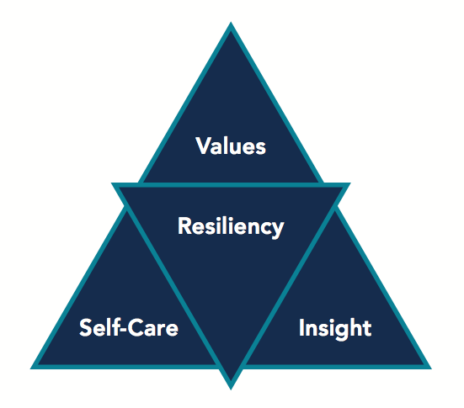
Ingredients Fostering Resident Wellness
Higher rates of burnout in residents with lower levels of mindfulness and coping skills
Insight and self-awareness necessary to recognize when one must practice self-care
More effective to teach these skills rather than taking time off
Chaukos D, Chad-Friedman E, Mehta DH et al. Risk and resilience factors associated with resident burnout. Academic Psychiatry. 2016.
Nedrow A, Steckler NA, Hardman J. Physician resilience and burnout: Can you make the switch? AAFP Family Practice Management. 2013
West CP, Drybye LN, Rabatin JT et al. Intervention to promote physician well-being, job satisfaction, and professionalism: A randomized clinical trial. JAMA. 2014
Notes:
Not just about preventing burnout, but rather, providing with the skills to manage stress when it inevitably occurs
Nedrow: extroverts need to find time for social connection; introverts need to find time for themselves
An individual’s self-awareness and ability to recognize when his or her attitudes are deteriorating, and then do something about it, may be a key difference between those with a healthy engagement in the practice of medicine and those suffering from burnout.

Slide 15
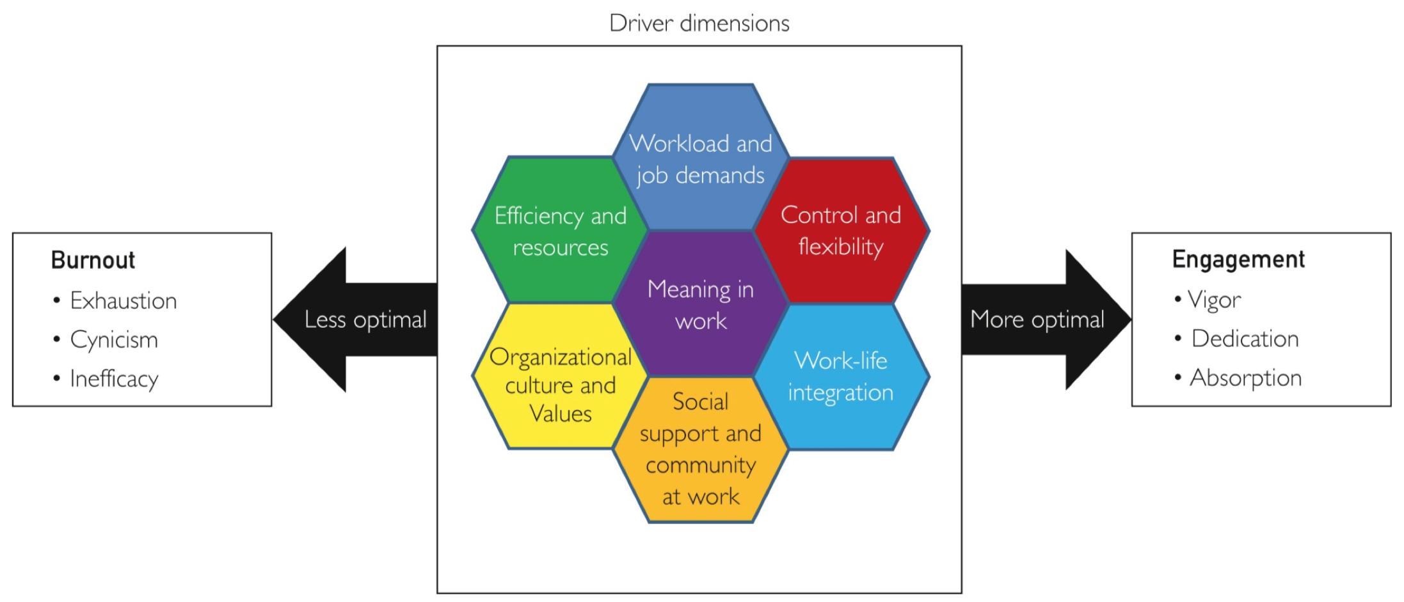
Driver Dimensions
Shanafelt TD, Noseworthy JH. Mayo Clin Proc. 2017;92-129-46.
Notes:
Diagram to show dimensions of burnout

Slide 16
Quadruple Aim:
Clinician Experience
Patient Experience
Lower
Costs
Better Outcomes
Notes:
The Quadruple Aim is a framework designed to help health care systems improve patient outcomes and the quality of care provided.
Originally the Triple Aim was about simultaneously improving the health of the population, enhancing the experience and outcomes of the patient, and reducing per capita cost of care.
This was updated to add a fourth aim.
The fourth piece of this interconnected pie relates to the clinician experience, for many organizations, the fourth aim is attaining joy in work or clinician wellness.
Increasing evidence is linking physician wellness to patient outcomes, medical-legal risk, and the performance of healthcare teams.

Slide 17
Group Reflection
How are we presently supporting ourselves and our residents regarding safety, wellness & resilience?
What kind of culture of safety and wellness do we presently have?
What kind of individual and programmatic wellness innovations do we want to strive to create in the future?
How can we make this happen?
Do you know where to find the resources to support your learner?
Notes:
Group Activity:
How do we identify

Slide 18
Group Reflection
Characteristic behaviour of doctors (What Doctors Do):
- Defer gratification
- Perfectionism
- Estrangement from body
- Forced stoicism in the face of suffering
- Emphasis on memory
- Performance vs authenticity

Slide 19
DFCM RED BUTTON - CLICK FOR HELP!
The Red Button is found at the top right hand corner of the DFCM website: https://www.dfcm.utoronto.ca/dfcm-red-button
Notes:
Resources for the learner

Slide 20
FoM Wellness Resources: https://pg.postmd.utoronto.ca/current-trainees/while-youre-training/access-wellness-resources/
https://pg.postmd.utoronto.ca/current-trainees/while-youre-training/access-wellness-resources/
Notes:
Resources available to Students – on FoM website – lots of resources and supports exist for medical students through the FoM, but also centrally on campus.

Slide 21
Strategies & Sustainability
Micro | Meso | Macro
Self-Reflection Balance & Prioritizing Personal Values Finding Pleasure & Purpose Self-compassion Mindfulness Health Humanities/Narrat-ive Medicine | Providing family physician Balint groups Residents retreat Social events/gatherings | Resources for MDs dealing with medical error Screening tools Receptive to MD input Cultivating sense of teamwork and community Reducing workload
Notes:
Micro
Meso
Macro
Recent studies and surveys have highlighted the extent of learner mistreatment (both students and residents) within the faculty of medicine and its learner sites.

Slide 22
Resources:
Burnout self-test
http://www.uapd.com/wp-content/uploads/Maslach-Burnout-Inventory-MBI.pdf
https://policybase.cma.ca/en/viewer?file=%2fdocuments%2fPolicypdf%2fPD18-01.pdf#phrase=false

Slide 23
Online Resources continued
https://www.studentlife.utoronto.ca/hwc/contact-us
https://md.utoronto.ca/student-mistreatment
https://md.utoronto.ca/sites/default/files/Protocol%20for%20addressing%20incidents%20of%20discrimination%2C%20harassment%2C%20mistreatment%20and%20other%20unprofessional%20behaviour_2019-02-05.pdf
https://medicine.utoronto.ca/asp/foster-culture-where-health-wellbeing-and-resiliency-are-promoted
https://www.provost.utoronto.ca/wp-content/uploads/sites/155/2020/01/Presidential-and-Provostial-Task-Force-Final-Report-and-Recommendations-Dec-2019.pdf
https://www.utoronto.ca/news/u-t-rolls-out-demand-my-ssp-counselling-service-all-students
(On demand support for UofT Students, includes an app to use on your phone)

Slide 24
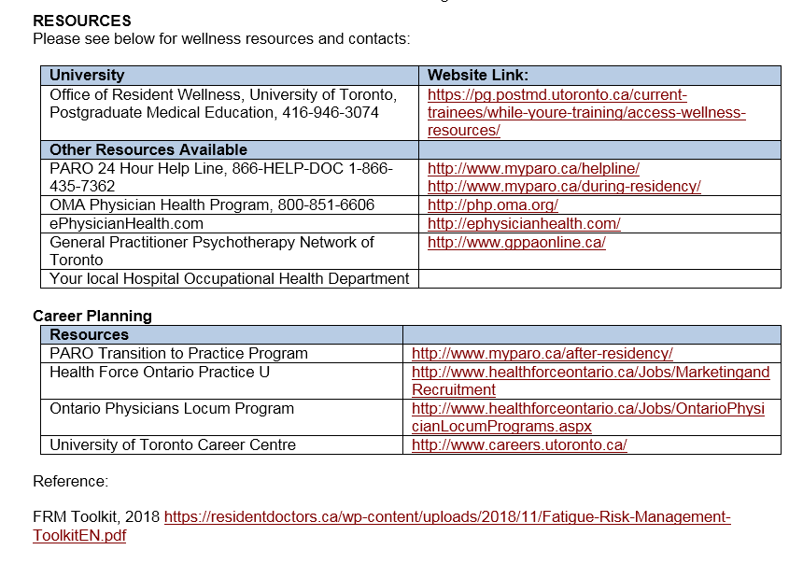
Notes:
Resources for the learner

Slide 25
References:
Mayo Clinic Nine Organizational Strategies to Promote Engagement & Reduce Burnout 2017
Colin West et al. Physician Burnout: Contributors, Consequences, and Solutions (2018)
Panagioti, et al,. Association Between Physician Burnout and Patient Safety, Professionalism, and Patient Satisfaction A Systematic Review and Meta-analysis JAMA Intern Med. 2018;178(10):1317-1330.
Tait Shanafelt et al. The Business Case for Investing in Physician Well-Being (2017)
Thomas Bodenheimer and Christine Sinsky. From Triple to Quadruple Aim (2014)
CMPA https://www.cmpa-acpm.ca/static-assets/pdf/about/annual-meeting/18_healthier_physicians_backgrounder-e.pdf
https://www.cmpa-acpm.ca/static-assets/pdf/about/annual-meeting/18_healthier_physicians_backgrounder-e.pdf
https://www.cfpc.ca/uploadedFiles/_Shared_Elements/Documents/20180701_RB_V1.2_ENG.pdf
http://dfcm.utoronto.ca/dfcm-red-button
https://pg.postmd.utoronto.ca/about-pgme/policies-guidelines/
Learner Mistreatment document prepared by Dr Patricia Houston , Dr Sal Spadafora Findings taken from "Voice of" student and resident surveys conducted by the FoM in 2019 AFMC Canadian graduate Questionnaire ( 2017-2019) & MD Program End of Course Evaluations 2018-19
Notes:
References

Slide 26
Acknowledgements
We wish to acknowledge and thank Dr. Milena Forte, Dr.Erin Bearss, Dr.Lindsay, Dr.Herzog, Dr. Diana Toubassi and Dr. Allan Peterkin for their previous presentations on Physician Wellness
We wish to acknowledge Dr. Vivian Tam R2 MSH, Dr. Julie Maggi Resident Wellness Director, Faculty of Medicine for their advice and feedback on this module

Slide 27
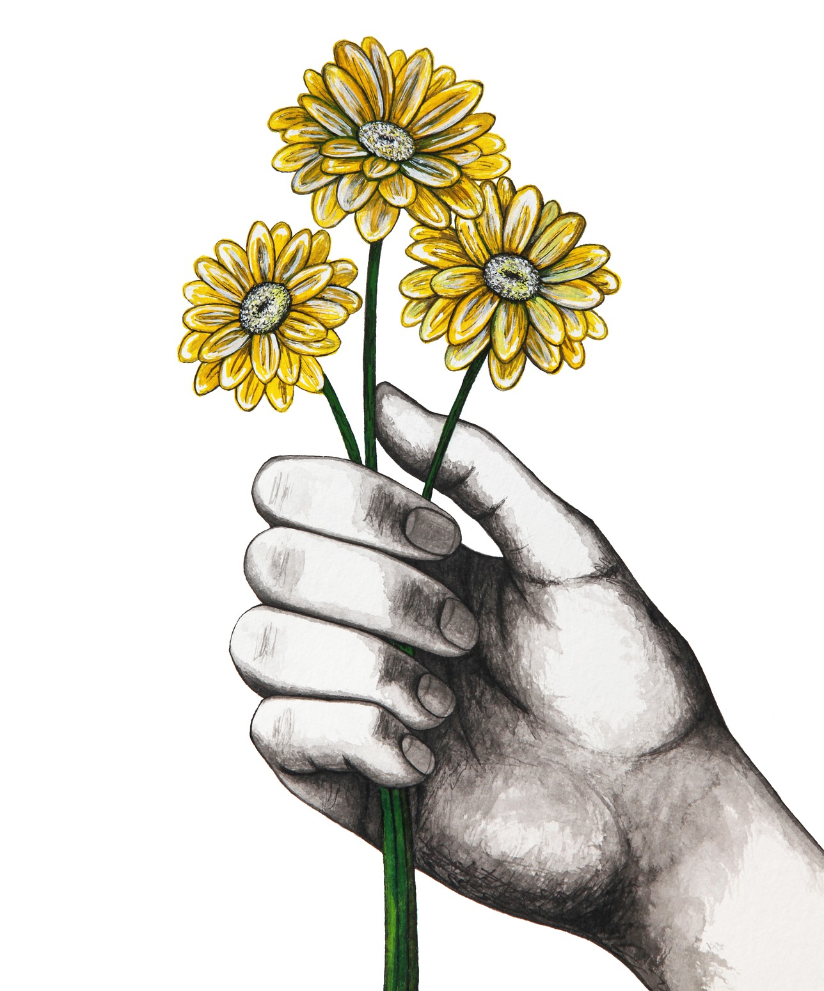
“I will give to my teachers, colleagues, and students the respect and gratitude that is their due….I will attend to my own health, well-being, and abilities in order to provide care of the highest standards”
From the revised Declaration of Geneva, adopted by the World Medical Association
Image by Nika Akin from Pixabay
Notes:
This is the last slide - can omit if desired

Slide 28
Extra Slides for Presenter Reference...

Slide 29
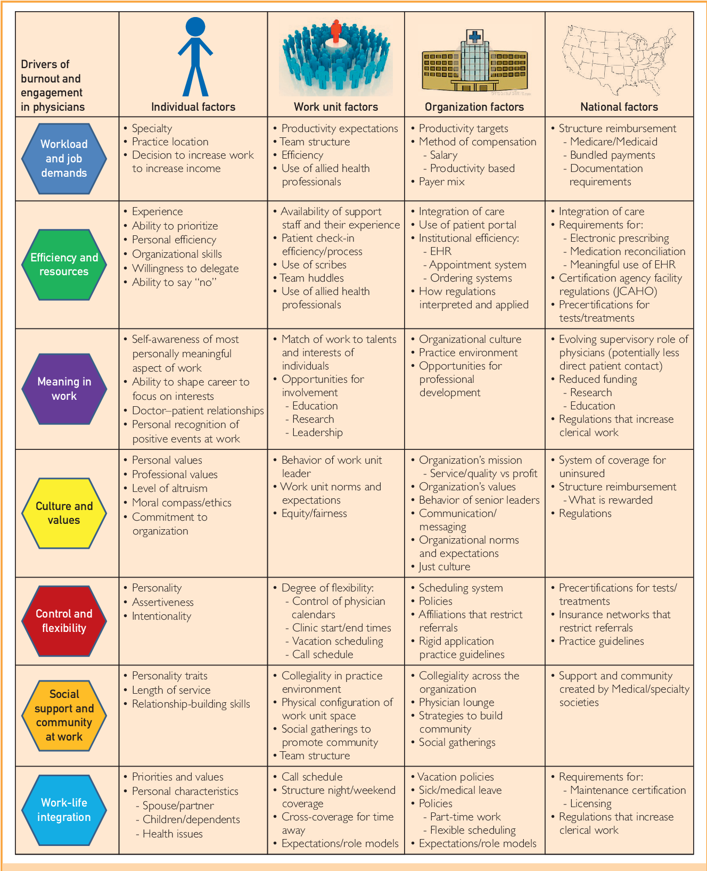
Just for reference

Slide 30
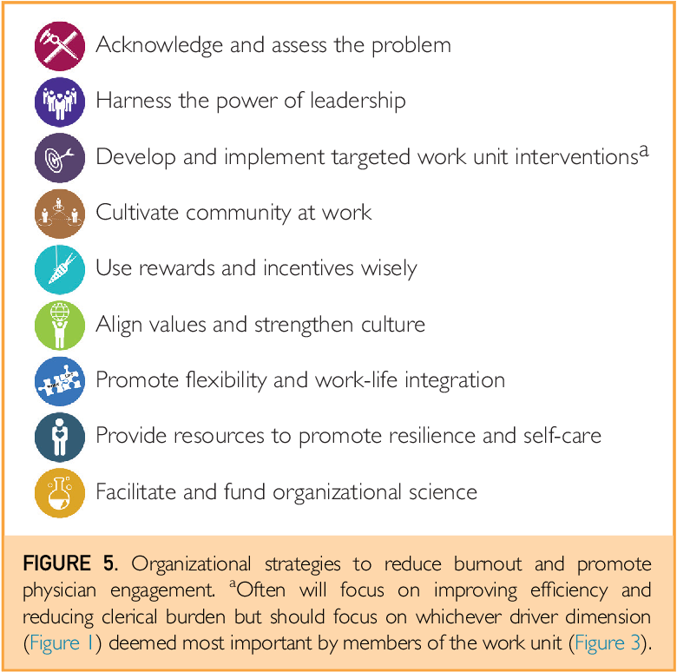
Just for reference

Slide 31
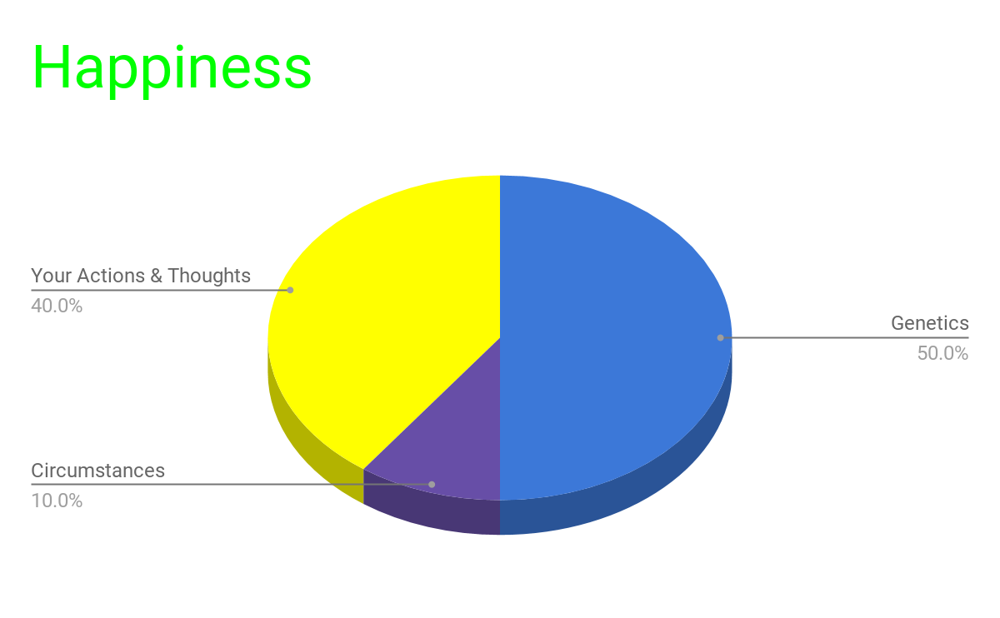
Just for reference
Lyubomirsky et al. 2005
Notes:
Actions and thoughts are skills,
Pendulum swung from individual to system
Both matter
The famous 50-10-40% formula is prominent in work done by positive psychologist Sonja Lyubomirsky. Based on a body of research in this field, she and her colleagues argued that approximately 50% of variance in happiness is determined by genes, and 10% of variance in happiness is determined by circumstances. That would leave 40% that we can influence.

Slide 32
Wellness Group Activity Options
Moment of Mindfulness
Narrative Medicine
Exercise
Improv
Notes:
We cut this to save time as started presentation with a poem.

